Slide 1
Planning and Managing the Project
A Module in Agile Fundamentals
Notes:
Plan, execute and report on Agile projects
--------------------------------------------------------------------------------------------------------------------
Welcome to the module Planning the Project. This module is brought to you by ThoughtWorks Studios, maker of Mingle, Cruise, and Twist.
In this module, we’ll explore the practices that help Managers and Project Managers plan, execute, and report on Agile projects.

Slide 2
Module Objectives
Learn the purpose and attributes of stories
Understand the relationship of stories, acceptance criteria and testing
Learn about roles and personas and scenarios
Learn how to estimate agile stories
Learn how to plan using estimates, spikes and velocity
Understand the agile lifecycle and planning cadence
Learn about agile metrics and communication

Slide 3
Collecting Stories
Notes:
Stories are the unit of work that gets measured, tracked, signed off.
Let’s talk about …………
Techniques for writing stories
Techniques for planning with stories
First the template
---------------------------------------------------------------------------------------------------------
While we talked about Stories in an earlier module on The Agile Core, we didn’t talk much about the process and the practices. Since Stories are one of the key tools in an Agile project, we’re going to talk a bit about some of the techniques that will help you in writing stories and working with them as part of the planning process.
Let’s start by reviewing the template for a user story.

Slide 4
User Stories
Three C’s
Card
Conversation
Confirmation
As a Librarian, I want to be able to search for books by publication year so that I can produce a chronological index
Notes:
Ron Jeffries – ‘Extreme Programming Installed’
Aspects of user stories
[CLICK]
Card – index card or virtual
Repository of information that is the requirements
Placeholder for [CLICK]
Conversation
Not enough info in the card
Has all the parts – Role, Goal, Value
What would the search results look like?
What are the search criteria?
Have the conversation when ready to do the work
Conversations with business, developers, testers
Document enough to do the work
[CLICK]
Confirmation
How we know the story is ‘done’
Acceptance criteria
“I will know this is complete when…..”
Story level acceptance criteria
---------------------------------------------------------------------------------------------------------------------------
You might say that User Stories are the “currency” of Agile Software Development. They are the central elements that identify what we’re doing and why we’re doing it.
Let’s consider the key aspects of User Stories.
First, there’s the Three C’s. [CLICK]
The first C is the Card, or story. Whether you are working in a physical world, and using index cards, or you are working in an electronic world like Mingle, and using virtual cards, this artifact serves two purposes: first, it is the repository of the information that is the story and is about the story; second, it is a placeholder for a future [CLICK]
Conversation. If you examine the story we have here, it is pretty obvious that there is not enough information here to know precisely what to build. It does follow the template, of course – the role is Librarian, the Goal is to have the capability to search books by publication year, and the value is so that a chronological index can be produced. But what would the search results look like? What would I do with them?
In order to clarify these questions, we would wait until we were ready to start development on our story, and then we’d have the Conversation. In the conversation we would dig into the details, figure out enough for the developers and testers to do their work, and document just enough of that information to enable us to do the work.
The third C is Confirmation. This is the combination of Acceptance Criteria and the actual testing to confirm that the goals and value of the story have been satisfied.
Without all three C’s, the story is not effective as a tool to guide the development of the software.

Slide 5
User Stories
Three C’s
INVEST
Card
I
Independent
N
Negotiable
Conversation
V
Valuable
E
Confirmation
Estimatable
S
Small
T
Testable
As a Librarian, I want to be able to search for books by publication year so that I can produce a chronological index
Notes:
Guidelines for writing good stories
Independent
Sales amount, sales percent, discount amount, discount percent
May want to split it – too big to fit into an iteration
Reports example. Or business rule applied to different products.
Write each as if they were the first story
Negotiable
Not a contract of what the software must implement
Conversations bring out details
Negotiate implementation, design
Get external links example.
Valuable
Valuable to the business, user, customer
This is the ‘So that’ part of the template
Everyone on the team should be able to articulate the value of the story
Estimatable
Clear and complete enough for the developers to estimate
If split as above, estimate the whole work for each.
Once foundation is complete, re-estimate the later stories
Small
Mike Cohn said it well:
“Like Goldilocks in search of a comfortable bed, some stories can be too big, some can be too small, and some can be just right. Story size does matter because if stories are too large or too small you cannot use them in planning.”
Must be completed in an Iteration.
Testable
Mike Cohn again:
“Stories must be written so as to be testable. Successfully passing its tests proves that a story has been successfully developed. If the story cannot be tested, how can the developers know when they have finished coding?”
----------------------------------------------------------------------------------------------------------
Next we have one of the key acronyms that helps us write and judge effective user stories: INVEST. This is one that you’ll want to learn, because you’ll find yourself using it all the time.
[CLICK] The I stands for Independent. As a valuable goal, we strive to ensure that each of our user stories is independent. That means that we try to write them in such a fashion that they can be estimated and implemented independently of other user stories. We’ll get into this in more detail later, because it’s such an important point. For now, let me give you an example: when working on a business intelligence project, a team wrote a story that included four measures in its Goal: sales amount, sales percent, discount amount, discount percent. At the first writing, this seemed to be a reasonable story. After a bit of understanding and experience was gained, it became clear that it made sense to break this into four stories. Of course, the development team’s first reaction was that they had to pick one story to do first, so that they could do all the underlying work with that story. That would mean that the other stories would be dependent on that story getting done first. This is a mistake that many teams make when working with stories. When we get further down in the INVEST acronym, we’ll talk more about why this is so.
[CLICK] The N stands for Negotiable. This means that stories are not written contracts or requirements that the software must implement. Story cards are short descriptions of functionality, the details of which are to be negotiated in a conversation between the customer and the development team. Because story cards are reminders to have a conversation rather than fully detailed requirements themselves, they do not need to include all relevant details. This allows room in the discussion, at the time the story is implemented, to negotiate some of the details and the implementation.
[CLICK] The V stands for Valuable. This means that it is valuable to purchasers or users of the software, and also means that it is valuable to the business. As we discussed earlier, when reviewing the story template, being able to articulate the value of a story is essential. Without being able to articulate and understand the value, it is reasonable to question why we’re writing or implementing a story.
[CLICK] The E stands for Estimatable. That means that a story must be at a fine enough granularity, with enough clarity and detail, that the team is able to estimate it. Let’s go back to the story we introduced when talking about the “I” for Independent. When this story first came up – the story including the four measures – the team estimated it relatively high, because of the combination of foundational work – adding to and modifying the database, for instance – and the detail required for each of the measures. Upon reflection, as noted earlier, the team opted to separate this story into four separate stories, one for each measure. The problem was with that Independence. They said “if we implement any one of these stories first, it will be an eight – any other story will be a two after that – so which story should we do first?” The answer was to estimate them all independently, as if they were going to do all of that foundational work on all of them. Of course, we know that that would not be the case, but it enables the team to maintain that independence. When it came time to choose among the stories for implementation, that left the Product Owner with the freedom to choose any of them, based on current priorities. Once the first story was done, the team could then re-estimate the remaining stories with the understanding that the foundational work had been done and the remaining stories would be easier to implement.
[CLICK] The S stands for Small. Mike Cohn said it well: “Like Goldilocks in search of a comfortable bed, some stories can be too big, some can be too small, and some can be just right. Story size does matter because if stories are too large or too small you cannot use them in planning.” Further, Mike says “The ultimate determination of whether a story is appropriately sized is based on the team, its capabilities, and the technologies in use.” When we work with Agile teams, one of the guidelines we use is whether a story can be completed in an Iteration.
[CLICK] And finally, the T stands for Testable. Let’s quote Mike Cohn again: “Stories must be written so as to be testable. Successfully passing its tests proves that a story has been successfully developed. If the story cannot be tested, how can the developers know when they have finished coding?”
Remember the acronym – INVEST – Independent, Negotiable, Valuable, Estimatable, Small, and Testable.

Slide 6

Parts of a Story
Unique #:
Title:
Description:
As a
I want to
So that
Assumptions:
Estimate:

Slide 7
Parts of a Story
I will know this is complete when…….

Slide 8
User Story Template
Role: As a …
Goal: I want/need …
Value: So that …
From User Stories Applied: For Agile Software Development by Mike Cohn
Notes:
From Mike Cohn’s book “User Stories Applied”.
Role
Identified during inception
Identifier for a common set of tasks or permissions
[CLICK]
Goal
What the user wants to do, not what the system is supposed to do.
The feature
[CLICK]
Value
Why are we building this functionality?
Should tie back to a business objective
--------------------------------------------------------------------------------------------------------------------
The story template we use comes from Mike Cohn’s book “User Stories Applied”. It has three parts:
The Role: this is an identifier for a common set of tasks or permissions.
The Goal: this is what is to be accomplished. This is stated in terms of what the person or role wants to accomplish, not what the system is supposed to do.
The Value: this is one of the most important parts. Without understanding what this story means to the person in the role or the organization – the business – we are left asking the question “why are we doing this?” The value statement may be the hardest part of user stories. Expressing the role and the goal are generally pretty clear, although we’ve seen some challenges there too. The value, though, is hard. People are inclined to say things like “because that’s my job!” or “so that we can do our business.”
We’ll come back to this template repeatedly as we go, because it’s such a key part of what we do and how we do it.

Slide 9
Acceptance Criteria
I’ll know this is complete when…….
Notes:
Inception level vs. Iteration level criteria
Inception - I’ll know this is complete when …… [CLICK]
Iteration Level…
Given – preconditions to the story. State of the system, object, role [CLICK]
When – the action[CLICK]
Then – the result
Gives context for estimating
Security is a good example.
I’ll know this is complete when each role logs in and they receive the proper access or not.
vs. each role spelled out in the Narrative as a separate Given, when then statement.
When each statement is fulfilled, the story is done
-------------------------------------------------------------------------------------------------------------------------------
Now that we have a story, we need to address that Testable attribute. We do this by defining the acceptance criteria. That is, we identify those criteria which, when met, allow us to assert that the story has been completely and successfully implemented.
While there are many ways to phrase or write the acceptance criteria, we prefer the scenario template devised by Dan North and Chris Matts, and first documented in an article by Dan published in Better Software magazine in March of 2006. You can read it on Dan’s blog at dannorth.net/introducing-bdd as you’ll see on the slide.
The template has three clauses, like the user story template. In this case, they specify…
[CLICK] the initial context, using the keyword “given”. This clause identifies the pre-existing conditions that must exist before we can execute or experience…
[CLICK] the event, or action, which is specified using the “when” keyword. Finally, we specify…
[CLICK] the outcomes or expectations using the “then” keyword. Here’s an example…
[CLICK] First, the context – the user must not be logged in. Note that the Given – the context – is NOT part of the test, but rather is the set-up. That is, in this case we assume that the ability to log in and the permissions associated with that logging in have been dealt with elsewhere. This particular scenario is focused on verifying that a user is required to log in before being able to click on the Shopping Cart link. It is not focusing on whether or not it is possible to log in.
Once the context is set up, then we have the specific event, or behaviour, that is executed. This is the action in the test. In this case, the action is to click on the Shopping Cart link.
Finally, the scenario specifies one or more outcomes. In this case, the user should be required to log in. This might more properly be written “a login form is presented to the user” since that is measurable.
It’s important to note that there may be multiple parts to the Context – the Given clause – and to the Outcomes – the Then clause – but there will normally be only a single part to the Event – the When clause.
The acceptance criteria should be written so that they are executable, preferably in code.
We’ll talk about when to add the acceptance criteria to a story later in this module.

Slide 10
Acceptance Criteria
The Context: Given…
The Event: When…
The Outcomes: Then…
Given that the user is not logged in
When the user clicks on the Shopping Cart link
Then they should be required to log in
Reference: Dan North’s Blog @ http://dannorth.net/introducing-bdd
Notes:
Inception level vs. Iteration level criteria
Inception - I’ll know this is complete when …… [CLICK]
Iteration Level…
Given – preconditions to the story. State of the system, object, role [CLICK]
When – the action[CLICK]
Then – the result
Gives context for estimating
Security is a good example.
I’ll know this is complete when each role logs in and they receive the proper access or not.
vs. each role spelled out in the Narrative as a separate Given, when then statement.
When each statement is fulfilled, the story is done
-------------------------------------------------------------------------------------------------------------------------------
Now that we have a story, we need to address that Testable attribute. We do this by defining the acceptance criteria. That is, we identify those criteria which, when met, allow us to assert that the story has been completely and successfully implemented.
While there are many ways to phrase or write the acceptance criteria, we prefer the scenario template devised by Dan North and Chris Matts, and first documented in an article by Dan published in Better Software magazine in March of 2006. You can read it on Dan’s blog at dannorth.net/introducing-bdd as you’ll see on the slide.
The template has three clauses, like the user story template. In this case, they specify…
[CLICK] the initial context, using the keyword “given”. This clause identifies the pre-existing conditions that must exist before we can execute or experience…
[CLICK] the event, or action, which is specified using the “when” keyword. Finally, we specify…
[CLICK] the outcomes or expectations using the “then” keyword. Here’s an example…
[CLICK] First, the context – the user must not be logged in. Note that the Given – the context – is NOT part of the test, but rather is the set-up. That is, in this case we assume that the ability to log in and the permissions associated with that logging in have been dealt with elsewhere. This particular scenario is focused on verifying that a user is required to log in before being able to click on the Shopping Cart link. It is not focusing on whether or not it is possible to log in.
Once the context is set up, then we have the specific event, or behaviour, that is executed. This is the action in the test. In this case, the action is to click on the Shopping Cart link.
Finally, the scenario specifies one or more outcomes. In this case, the user should be required to log in. This might more properly be written “a login form is presented to the user” since that is measurable.
It’s important to note that there may be multiple parts to the Context – the Given clause – and to the Outcomes – the Then clause – but there will normally be only a single part to the Event – the When clause.
The acceptance criteria should be written so that they are executable, preferably in code.
We’ll talk about when to add the acceptance criteria to a story later in this module.

Slide 11




Roles
Notes:
So how do we get these stories?
Through a number of analysis sessions.
Roles, the first part of our story template.
Roles define a set of actions and permissions
Initially identified during inception. Can be added, eliminated.
One person may fulfill multiple roles
Consider Fred [CLICK]
Fred is in the sales department. [CLICK]
Salesman [CLICK]
Super user for the sales automation team [CLICK]
Clerical or administrative work for the Customer Service group
By discussing what these roles will likely do with the system, we get stories
----------------------------------------------------------------------------------------------------------
In talking about our template for user stories, the first clause is the Role clause.
Roles, not to be confused with Personas, identify the ways in which the system will be used. Those ways reflect a particular type of user or member of an organization. There is nothing personal about a Role, and Roles need not be mutually exclusive. Further, a single individual (real or Persona) may act in or fill multiple roles, and may take on different Roles at different times.
It is essential to identify the core set of Roles that are the subjects of stories.
Additional Roles may be identified over time, and Roles may be combined or eliminated.
So let’s consider our friend Fred here [CLICK]. Fred is in the Sales department. Sometimes, [CLICK] Fred is a salesman, doing what salesmen do.
Sometimes, [CLICK] because of his technical expertise, Fred is the superuser for the sales automation system.
And sometimes, [CLICK] Fred does clerical and administrative work, like after a big trade show when he enters information about all the people that came to his company’s booth.
As you can see, roles are about activities and permissions, and not about people.

Slide 12
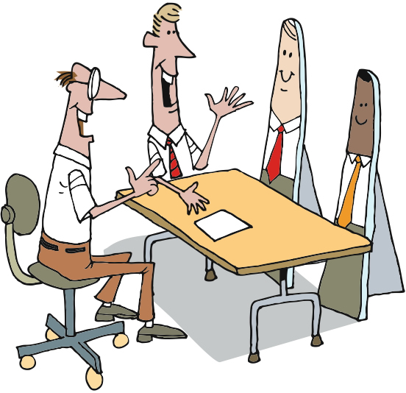
Personas
Notes:
Created individuals given names – Bill, Jack
Have characteristics like – biographic, technographic, attitudes, relationship to/from the business, etc
Used to create paths through the system
“How would Bill search for a flight?”
Bill and Jack may have the same role, but different Personas
By discussing the different personas and how they’d interact with the system we get stories.
---------------------------------------------------------------------------------------------------------------------
Now let’s talk about Personas.
Personas are created people. They combine sets of characteristics that allow the project team to talk about them as if they were real. The advantages over using real people are that there’s no danger of offending someone when we talk about them, there’s no need to ask someone personal questions, the personas are crafted to satisfy a need, and they don’t have to get fed or paid. [hopefully, this will get a chuckle – pause for the chuckle]
Personas take on Roles, just like real people. However, unlike Roles, they are not incorporated into Stories. Rather they are used as the context and checkpoint for Stories. That is, if there are Personas named Sharon and Fred, we might ask “How would Fred do that?” or “Would that satisfy Sharon?”
The more we talk about them, the more real they become. We work hard to avoid saying “What would a Superuser do?” when talking about acceptance criteria and system flow, and try to stay with the Personas. That helps us remember that more than one Persona may take on the same Role, and that each Persona can take on multiple Roles.

Slide 13
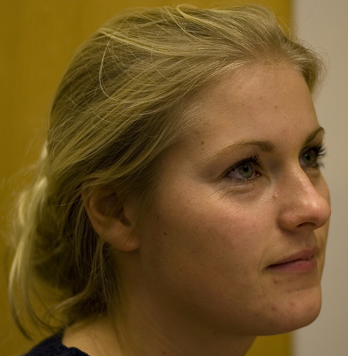
Personas
Jane, the QA Manager
37 Years Old
Married
No children
Two dachshunds, both female
Worked her way up from tester
BS in MIS
Hobbies: bicycling, musical theater
Subscribes to Quality Software Magazine
Photo from JesperM on Flickr @ http://www.flickr.com/photos/51344793@N00/353164703/
Notes:
To create a persona we discuss
Background and history
Professional experience
Technological level
Hobbies
Goals
Relationship to the business
Find a photograph that gives the persona visibility
Hung up in the team room
----------------------------------------------------------------------------------------------
To create personas, we talk about their background and history, their professional experience, their families, their education, their hobbies, and more. We try to make them as real as possible.
Typically, we will find a photograph – usually from a clipart site, so it’s not someone we know – to use for the persona. We’ll create persona sheets – profiles with the picture – and put them where they’re visible to all of the members of the team.
Once we’ve identified a persona, and as we begin to flesh them out, we’ll start to develop scenarios.

Slide 14
Why Roles AND Personas?
Role
Persona
Characteristics & Behaviors
Activities & Permissions
Drives story value
Drives scenarios
Is impersonal
Is personal and “real”
May be individual or collective
Is individual
Notes:
Add some content about how we use each - personas in both forward and backward looking, BA/UX, Dev,...

Slide 15
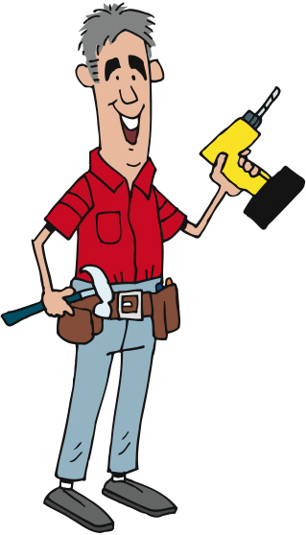
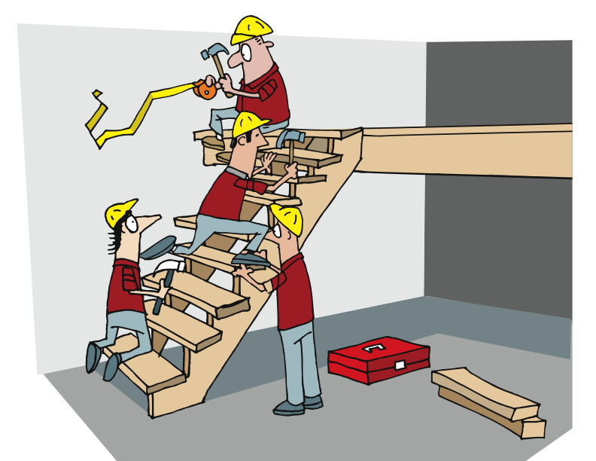
Scenarios
Scenario
=
a persona
+
a task
+
an environment
Notes:
A story about how a persona might accomplish a task
Book a flight
The super user may jump directly to a particular airline
The casual user may want to browse all airlines
Some current processes, some visionary or new
-------------------------------------------------------------------------------------------------------------
We use Scenarios to drive out requirements and to validate that solutions can solve the tasks identified in all possible environments. This is where we might see various personas taking on multiple roles and helping us to understand how they would use, and respond to, the solution we’re developing. In fact, Scenarios tie pretty directly to the way in which we state our acceptance criteria.
Some of the scenarios we create will be current – how things work today – and some will be visionary – how things will be sometime in the future. All of them will help us to understand how the system we’re building will effectively serve our customers.

Slide 16
Use Cases to Scenarios
1 Use Case
Many scenarios…
Start of use case
Step 1
Alt 1
Step 2
Step 3
Alt 3
Step 4
Step 5
Step 6
Alt 2
Step 7
End of use case
Notes:
Another source of stories are use cases.
Use cases can be broken down into scenarios.
The scenarios can then be dissected for stories.

Slide 17
Low-Fi Prototyping
“a prototype that is sketchy and incomplete, that has some characteristics of the target product but is otherwise simple, usually in order to quickly produce the prototype and test broad concepts.”
From http://www.usabilityfirst.com/glossary/term_378.txl:
Notes:
I’ll let you read this before we begin.
[PAUSE LONG ENOUGH TO READ THIS AT LEAST ONCE]
Allows you to run scenarios through the system without coding anything
Low cost
Paper
Another name for low-fidelity prototyping is "paper prototyping" and perhaps this name more fittingly describes what you use in the process. The purpose of the low-fidelity prototype is to allow you to design the interface of your application before you focus on anything else.

Slide 18
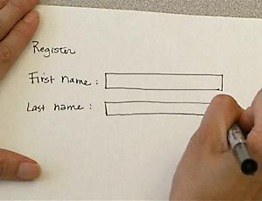
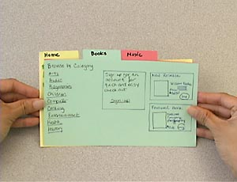
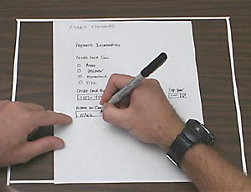
Low-Fi Prototyping
Notes:
Allows teams to test out interfaces without writing code.
Easy and inexpensive modifications
User is involved and comfortable being critical of a paper document vs a coded look
By running the various scenarios through the prototypes, you can find new requirements
Mid fi – Balsamiq
-------------------------------------------------------------------------------------
From an article in Wikipedia, we get:
Paper prototyping saves time and money since it enables developers to test product interfaces (from software and websites to cell phones and microwave ovens) before they write code or begin development. This also allows for easy and inexpensive modification to existing designs which makes this method useful in the early phases of design. Using paper prototyping allows the entire creative team to be involved in the process, which eliminates the chance of someone with key information not be involved in the design process. Another benefit of paper prototyping is that users feel more comfortable being critical of the mock up because it doesn’t have a polished look.
There are different methods of paper prototyping, each of them showing several benefits regarding the communication within the development team and the quality of the product to be developed: In the development team paper prototypes can serve as a visual specification of the graphical user interface, and by this means assure the quality of a software. Prototyping forces a more complete design of the user interface to be captured. In team meetings they provide a communication base between the team members. Testing prototypes at an early stage in development helps to identify software usability problems even before any code is written. The costs and annoyances of later changes are reduced, the support burden is lowered, and the overall quality of the software or website is increased.

Slide 19
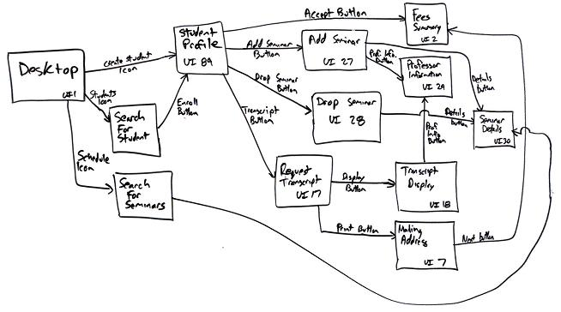
Storyboarding
Notes:
Intersects with Prototyping, Roles, Personas
Maps the interface flow of stories through the system.
Models the user interactions with the product.
High level overview of the product
-----------------------------------------------------------------------------
Storyboarding is another technique, and it intersects with Low-Fi Prototypes, Roles, and Personas.
Storyboards identify a flow of activities in the software/system, with each “frame” of the story representing a step in the process. Storyboards are similar in some ways to Flow Charts, except that they are more textual and contextual.
User interface-flow diagrams are typically used for one of two purposes. First, they are used to model the interactions that users have with your software, as defined in a single use case. For example, a use case can refer to several screens and provides insight into how they are used. Based on this information, you can develop a user interface-flow diagram that reflects the behavioral view of the single use case. Second, they enable you to gain a high-level overview of the user interface for your application. This overview is effectively the combination of all the behavioral views derived from your use cases, the result being called the architectural view of your user interface

Slide 20
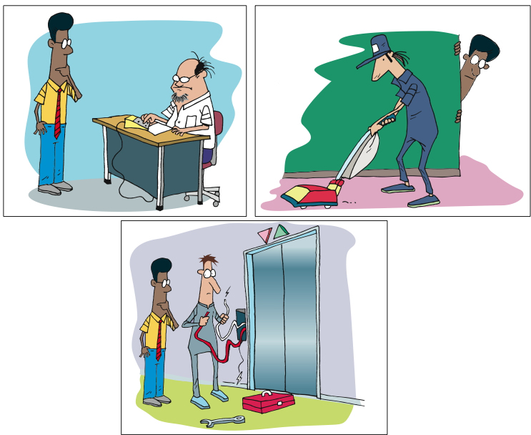
Contextual Design & Contextual Inquiry
Notes:
A component of Contextual Design
Observing someone do their job and then applying the understanding to the design.
Reduces misunderstandings of a process and missed steps that users forget to describe.
Get information A, get information B, etc is different if that information comes from one system vs different places
----------------------------------------------------------------------------------
One of the ways in which we gather information is through Contextual Inquiry.
Contextual Inquiry is a component of a design approach called Contextual Design, developed by Beyer & Holtzblatt.
The approach focuses on observing users as they do their jobs, and then [CLICK] applying that contextual understanding to design.
Context is important to understanding. Without context, we are subject to misunderstanding, and to building the wrong thing.
Gaining an understanding of how and why and where and when our prospective users and customers do what they do will enable us to more effectively meet their needs.

Slide 21
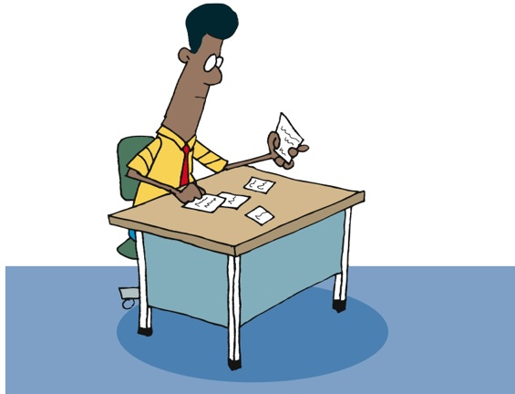
Contextual Design & Contextual Inquiry
Use learning to inform story writing and acceptance criteria
Notes:
A component of Contextual Design
Observing someone do their job and then applying the understanding to the design.
Reduces misunderstandings of a process and missed steps that users forget to describe.
Get information A, get information B, etc. is different if that information comes from one system vs. different places
----------------------------------------------------------------------------------
One of the ways in which we gather information is through Contextual Inquiry.
Contextual Inquiry is a component of a design approach called Contextual Design, developed by Beyer & Holtzblatt.
The approach focuses on observing users as they do their jobs, and then [CLICK] applying that contextual understanding to design.
Context is important to understanding. Without context, we are subject to misunderstanding, and to building the wrong thing.
Gaining an understanding of how and why and where and when our prospective users and customers do what they do will enable us to more effectively meet their needs.

Slide 22
In Summary
Template of a Story
3 Cs
INVEST
Acceptance Criteria
Roles
Personas
Scenarios
Prototyping
Story Boarding
Contextual Analysis

Slide 23
Estimating Stories
Notes:
We’ve got stories built from our flows, prototypes, personas, scenarios
Now we need to estimate them
Now that we’ve talked about stories and roles and personas and low-fi prototyping and storyboarding – that is, the tools and artifacts that enable us to know what we’ll be building - let’s talk about how we do our planning and communicating.

Slide 24
Estimating the Effort
Notes:
Accuracy – degree of closeness
Precision – reproducibility or repeatability
Results of calculations or measurements can be:
Accurate but not precise
Precise but not accurate
----------------------------------------------------------------------------------------------------------
Agile estimation is one of the parts that folks new to Agile struggle with. In this section, we’ll dig into the why and the how, and then give you some very specific practices.
Let’s begin with gaining an understanding of the terms “accuracy” and “precision”.
From Wikipedia, we get this definition: [CLICK]
In the fields of science, engineering, industry and statistics, accuracy is the degree of closeness of a measured or calculated quantity to its actual (true) value.
Accuracy is closely related to precision, also called reproducibility or repeatability, the degree to which further measurements or calculations show the same or similar results.
The results of calculations or a measurement can be accurate but not precise, precise but not accurate, neither, or both. A measurement system or computational method is called valid if it is both accurate and precise. The related terms are bias (non-random or directed effects caused by a factor or factors unrelated by the independent variable) and error (random variability), respectively.

Slide 25
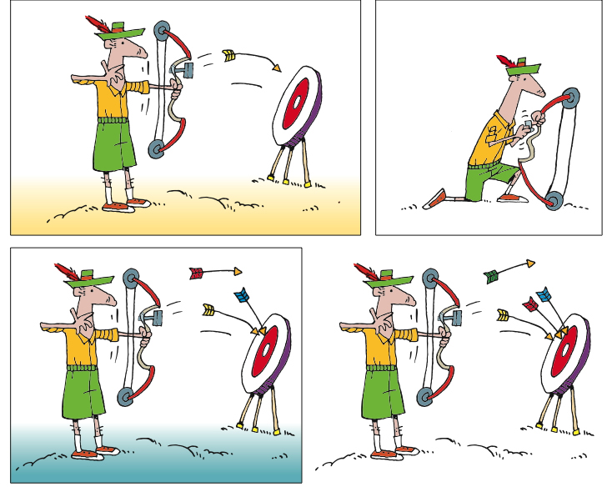
Accuracy and Precision
Notes:
Goals around both Accuracy and Precision in Agile estimation
There is accountability
Accuracy is hard
Who will do the work – different skill sets, capabilities [CLICK]
Precision requires consistent accuracy, therefore maybe adjusting assumptions, etc
----------------------------------------------------------------------------------------------
Based on the definitions of accuracy and precision, we have goals around both in Agile estimation. However, the challenge we face is to understand the value of each.
Accuracy is important when we are estimating in a time-based system. Whether person-hours/days or ideal hours/days, accuracy is measurable. When it is measurable, there is accountability. Being accurate is hard, especially when the team includes people of different capability, speed, and consistency, and it is not known who will perform the work when the estimate is made.
[CLICK] Precision is important when we are estimating as a group, and over time. Precision generally refers to how consistent we are in our estimation, both across the members of the team, and across time. The ideal test would be to estimate a story today, and estimate it again a week or a month or a year from now, and to see whether we come up with the same estimate.

Slide 26
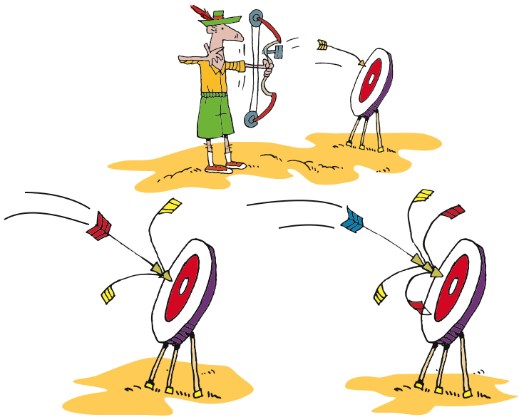
Accuracy and Precision
Notes:
Goals around both Accuracy and Precision in Agile estimation
There is accountability
Accuracy is hard
Who will do the work – different skill sets, capabilities [CLICK]
Precision requires consistent accuracy, therefore maybe adjusting assumptions, etc
----------------------------------------------------------------------------------------------
Based on the definitions of accuracy and precision, we have goals around both in Agile estimation. However, the challenge we face is to understand the value of each.
Accuracy is important when we are estimating in a time-based system. Whether person-hours/days or ideal hours/days, accuracy is measurable. When it is measurable, there is accountability. Being accurate is hard, especially when the team includes people of different capability, speed, and consistency, and it is not known who will perform the work when the estimate is made.
[CLICK] Precision is important when we are estimating as a group, and over time. Precision generally refers to how consistent we are in our estimation, both across the members of the team, and across time. The ideal test would be to estimate a story today, and estimate it again a week or a month or a year from now, and to see whether we come up with the same estimate.

Slide 27
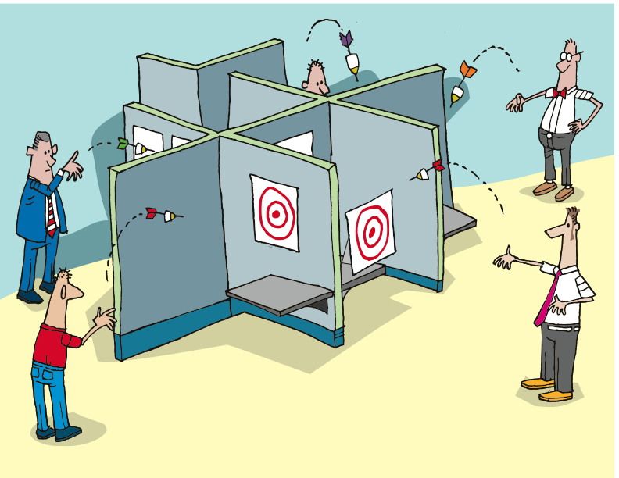
Notes:
Estimates are basically guesses.

Slide 28
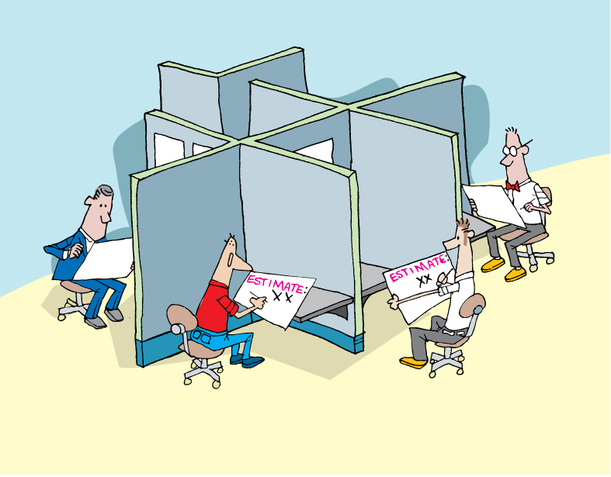
Notes:
Estimating in isolation leads to inaccurate estimates.
No discussion, questions, clarifications

Slide 29

Estimating as a group
Notes:
Estimation is a group effort in Agile
Contributions from all team leads to greater accuracy and precision
We work with NUTs – focusing on relative complexity. Sizing one story compared to others.
Planning poker is a practice
First we each think about the estimate [CLICK]

Slide 30
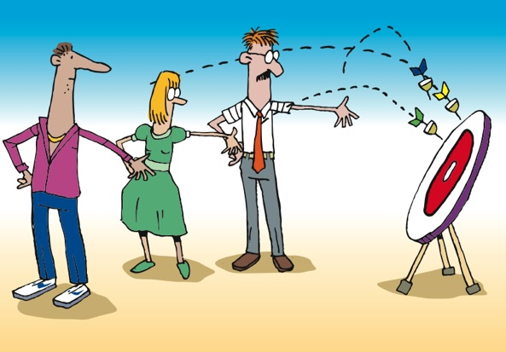
Estimating as a group
Notes:
Then we share our estimates [CLICK]

Slide 31

Estimating as a group
Notes:
We consider differences in the estimates [CLICK]
Focusing on outliers

Slide 32

Estimating as a group
Notes:
Then we have discussions about why each of us through different estimates.

Slide 33
Estimating as a group
Notes:
Then we through again.
We don’t need to get to consensus. Just clarity about where the assumptions are.

Slide 34
Agile Estimation: Planning Poker
0 + 1 = 1
1 + 1 = 2
1 + 2 = 3
2 + 3 = 5
3 + 5 = 8
5 + 8 = 13
8 + 13 = 21
Notes:
Various systems of estimates used
We use the Fibonacci Sequence
Documented by Leonardo Pisano Bogollo aka Leonardo Fibonacci
Perhaps the most talented mathematician of the middle ages
Each number is the sum of the previous 2 [CLICK]
Teams usually define what system they will use. 1,2,3,5, 8
------------------------------------------------------------------------------------------------------------------
There are various systems of estimation used, when applying Planning Poker. We use the Fibonacci Sequence numbers. The Fibonacci Sequence was documented by Leonardo Pisano Bogollo, also known as Leonardo Fibonacci, who was considered to be perhaps the most talented mathematician of the Middle Ages.
In the Fibonacci sequence, each number is the sum of the previous two numbers, starting with 0 and 1. Thus the sequence begins 0, 1, 1, 2, 3, 5, 8, 13, 21, 34
For Planning Poker, we use 0, 1, 2, 3, 5, 8, and 13. Some include 20 and 40 and 100 in our planning poker decks, in order to indicate that a story is too large to be done in a single iteration.

Slide 35
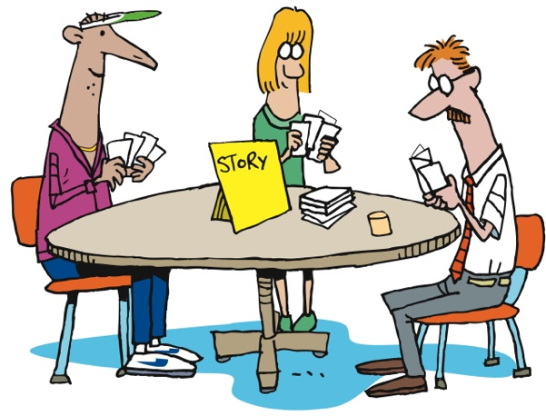
Agile Estimation: Planning Poker
Notes:
How does it work?
First the BA presents the story to the team.
Then everyone thinks about the estimate [CLICK]
Then everyone throws their estimate at the same time
No one is influenced by anyone else [CLICK]
There may be outliers [CLICK]
There is discussion about the outliers [CLICK]
Everyone re-thinks [CLICK]
Then re-throw
Sometimes necessary, sometimes not
----------------------------------------------------------------------------------------------------------------
Let’s look at how it’s done…
First, we gain a clear understanding of the story, including the acceptance criteria and the tasks needed to complete the story. Once all members of the team feel that they have that understanding, each member of the team selects the number that they feel represents the relative complexity of the story, as compared to other stories that the team has implemented.
As a group, [CLICK] team members reveal their estimates – the numbers they have chosen, that is. Revealing all at once prevents any team member from being influenced by another team member’s estimate.
It’s not unusual for there to be outliers [CLICK] – estimates that are different from the majority. When this happens, [CLICK] the team discusses the differences. Some will have thought of other tasks, or understood the tasks differently. Sometimes it’s QA who sees things differently. [CLICK]
Regardless, after discussing things, the team [CLICK] estimates again. If it takes more than three rounds of estimating, there’s a smell that needs to be addressed. The story may need to be rewritten or more analysis may need to be done.
Of course, sometimes the people who have thrown the outliers will agree to change their estimates without another round of estimating, once they understand the thinking of their teammates. In this case, no additional rounds of Planning Poker are needed for that story.

Slide 36
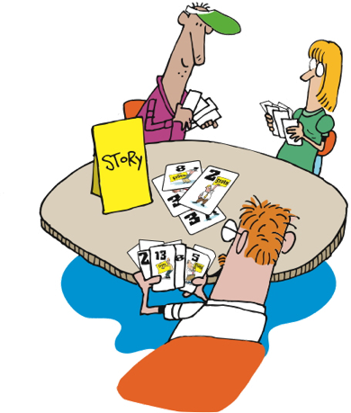
Agile Estimation: Planning Poker
Notes:
How does it work?
First the BA presents the story to the team.
Then everyone thinks about the estimate [CLICK]
Then everyone throws their estimate at the same time
No one is influenced by anyone else [CLICK]
There may be outliers [CLICK]
There is discussion about the outliers [CLICK]
Everyone re-thinks [CLICK]
Then re-throw
Sometimes necessary, sometimes not
----------------------------------------------------------------------------------------------------------------
Let’s look at how it’s done…
First, we gain a clear understanding of the story, including the acceptance criteria and the tasks needed to complete the story. Once all members of the team feel that they have that understanding, each member of the team selects the number that they feel represents the relative complexity of the story, as compared to other stories that the team has implemented.
As a group, [CLICK] team members reveal their estimates – the numbers they have chosen, that is. Revealing all at once prevents any team member from being influenced by another team member’s estimate.
It’s not unusual for there to be outliers [CLICK] – estimates that are different from the majority. When this happens, [CLICK] the team discusses the differences. Some will have thought of other tasks, or understood the tasks differently. Sometimes it’s QA who sees things differently. [CLICK]
Regardless, after discussing things, the team [CLICK] estimates again. If it takes more than three rounds of estimating, there’s a smell that needs to be addressed. The story may need to be rewritten or more analysis may need to be done.
Of course, sometimes the people who have thrown the outliers will agree to change their estimates without another round of estimating, once they understand the thinking of their teammates. In this case, no additional rounds of Planning Poker are needed for that story.

Slide 37
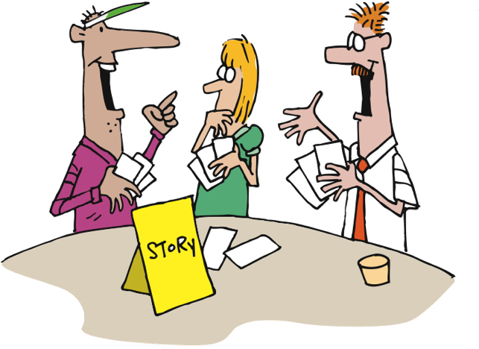
Agile Estimation: Planning Poker
Notes:
How does it work?
First the BA presents the story to the team.
Then everyone thinks about the estimate [CLICK]
Then everyone throws their estimate at the same time
No one is influenced by anyone else [CLICK]
There may be outliers [CLICK]
There is discussion about the outliers [CLICK]
Everyone re-thinks [CLICK]
Then re-throw
Sometimes necessary, sometimes not
----------------------------------------------------------------------------------------------------------------
Let’s look at how it’s done…
First, we gain a clear understanding of the story, including the acceptance criteria and the tasks needed to complete the story. Once all members of the team feel that they have that understanding, each member of the team selects the number that they feel represents the relative complexity of the story, as compared to other stories that the team has implemented.
As a group, [CLICK] team members reveal their estimates – the numbers they have chosen, that is. Revealing all at once prevents any team member from being influenced by another team member’s estimate.
It’s not unusual for there to be outliers [CLICK] – estimates that are different from the majority. When this happens, [CLICK] the team discusses the differences. Some will have thought of other tasks, or understood the tasks differently. Sometimes it’s QA who sees things differently. [CLICK]
Regardless, after discussing things, the team [CLICK] estimates again. If it takes more than three rounds of estimating, there’s a smell that needs to be addressed. The story may need to be rewritten or more analysis may need to be done.
Of course, sometimes the people who have thrown the outliers will agree to change their estimates without another round of estimating, once they understand the thinking of their teammates. In this case, no additional rounds of Planning Poker are needed for that story.

Slide 38

Agile Estimation: Planning Poker
Notes:
How does it work?
First the BA presents the story to the team.
Then everyone thinks about the estimate [CLICK]
Then everyone throws their estimate at the same time
No one is influenced by anyone else [CLICK]
There may be outliers [CLICK]
There is discussion about the outliers [CLICK]
Everyone re-thinks [CLICK]
Then re-throw
Sometimes necessary, sometimes not
----------------------------------------------------------------------------------------------------------------
Let’s look at how it’s done…
First, we gain a clear understanding of the story, including the acceptance criteria and the tasks needed to complete the story. Once all members of the team feel that they have that understanding, each member of the team selects the number that they feel represents the relative complexity of the story, as compared to other stories that the team has implemented.
As a group, [CLICK] team members reveal their estimates – the numbers they have chosen, that is. Revealing all at once prevents any team member from being influenced by another team member’s estimate.
It’s not unusual for there to be outliers [CLICK] – estimates that are different from the majority. When this happens, [CLICK] the team discusses the differences. Some will have thought of other tasks, or understood the tasks differently. Sometimes it’s QA who sees things differently. [CLICK]
Regardless, after discussing things, the team [CLICK] estimates again. If it takes more than three rounds of estimating, there’s a smell that needs to be addressed. The story may need to be rewritten or more analysis may need to be done.
Of course, sometimes the people who have thrown the outliers will agree to change their estimates without another round of estimating, once they understand the thinking of their teammates. In this case, no additional rounds of Planning Poker are needed for that story.

Slide 39
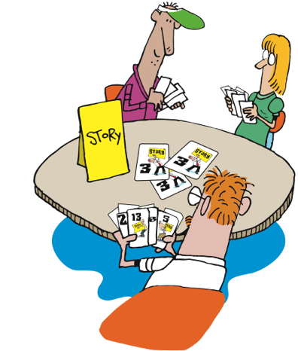
Agile Estimation: Planning Poker
Notes:
How does it work?
First the BA presents the story to the team.
Then everyone thinks about the estimate [CLICK]
Then everyone throws their estimate at the same time
No one is influenced by anyone else [CLICK]
There may be outliers [CLICK]
There is discussion about the outliers [CLICK]
Everyone re-thinks [CLICK]
Then re-throw
Sometimes necessary, sometimes not
----------------------------------------------------------------------------------------------------------------
Let’s look at how it’s done…
First, we gain a clear understanding of the story, including the acceptance criteria and the tasks needed to complete the story. Once all members of the team feel that they have that understanding, each member of the team selects the number that they feel represents the relative complexity of the story, as compared to other stories that the team has implemented.
As a group, [CLICK] team members reveal their estimates – the numbers they have chosen, that is. Revealing all at once prevents any team member from being influenced by another team member’s estimate.
It’s not unusual for there to be outliers [CLICK] – estimates that are different from the majority. When this happens, [CLICK] the team discusses the differences. Some will have thought of other tasks, or understood the tasks differently. Sometimes it’s QA who sees things differently. [CLICK]
Regardless, after discussing things, the team [CLICK] estimates again. If it takes more than three rounds of estimating, there’s a smell that needs to be addressed. The story may need to be rewritten or more analysis may need to be done.
Of course, sometimes the people who have thrown the outliers will agree to change their estimates without another round of estimating, once they understand the thinking of their teammates. In this case, no additional rounds of Planning Poker are needed for that story.

Slide 40
Thrown Estimates
Notes:
Accuracy – degree of closeness
Precision – reproducibility or repeatability
Results of calculations or measurements can be:
Accurate but not precise
Precise but not accurate
----------------------------------------------------------------------------------------------------------
Agile estimation is one of the parts that folks new to Agile struggle with. In this section, we’ll dig into the why and the how, and then give you some very specific practices.
Let’s begin with gaining an understanding of the terms “accuracy” and “precision”.
From Wikipedia, we get this definition: [CLICK]
In the fields of science, engineering, industry and statistics, accuracy is the degree of closeness of a measured or calculated quantity to its actual (true) value.
Accuracy is closely related to precision, also called reproducibility or repeatability, the degree to which further measurements or calculations show the same or similar results.
The results of calculations or a measurement can be accurate but not precise, precise but not accurate, neither, or both. A measurement system or computational method is called valid if it is both accurate and precise. The related terms are bias (non-random or directed effects caused by a factor or factors unrelated by the independent variable) and error (random variability), respectively.

Slide 41




Agile Estimation: Thrown Estimates
Like “Rock Paper Scissors”
Use finger counting
Everyone “throws” their estimate after a count of 3
“One, two, three, Throw!”
Can estimate 1, 2, 3, or 5
1
2
3
?
http://martinfowler.com/bliki/ThrownEstimate.html
Notes:
This variation is one that we have used. We throw 1, 2, or 3 as valid estimates. 5 is NOT a valid estimate and means “I have no idea”. If someone throws that then we need to have a conversation.
Teams may have their own variations on this. Sometimes people can abstain by throwing “rock” (a fist).
Note: demonstrate to them the counting in strategy you will use! “One, two, three, throw!”
From Martin Fowler’s website: http://martinfowler.com/bliki/ThrownEstimate.html

Slide 42
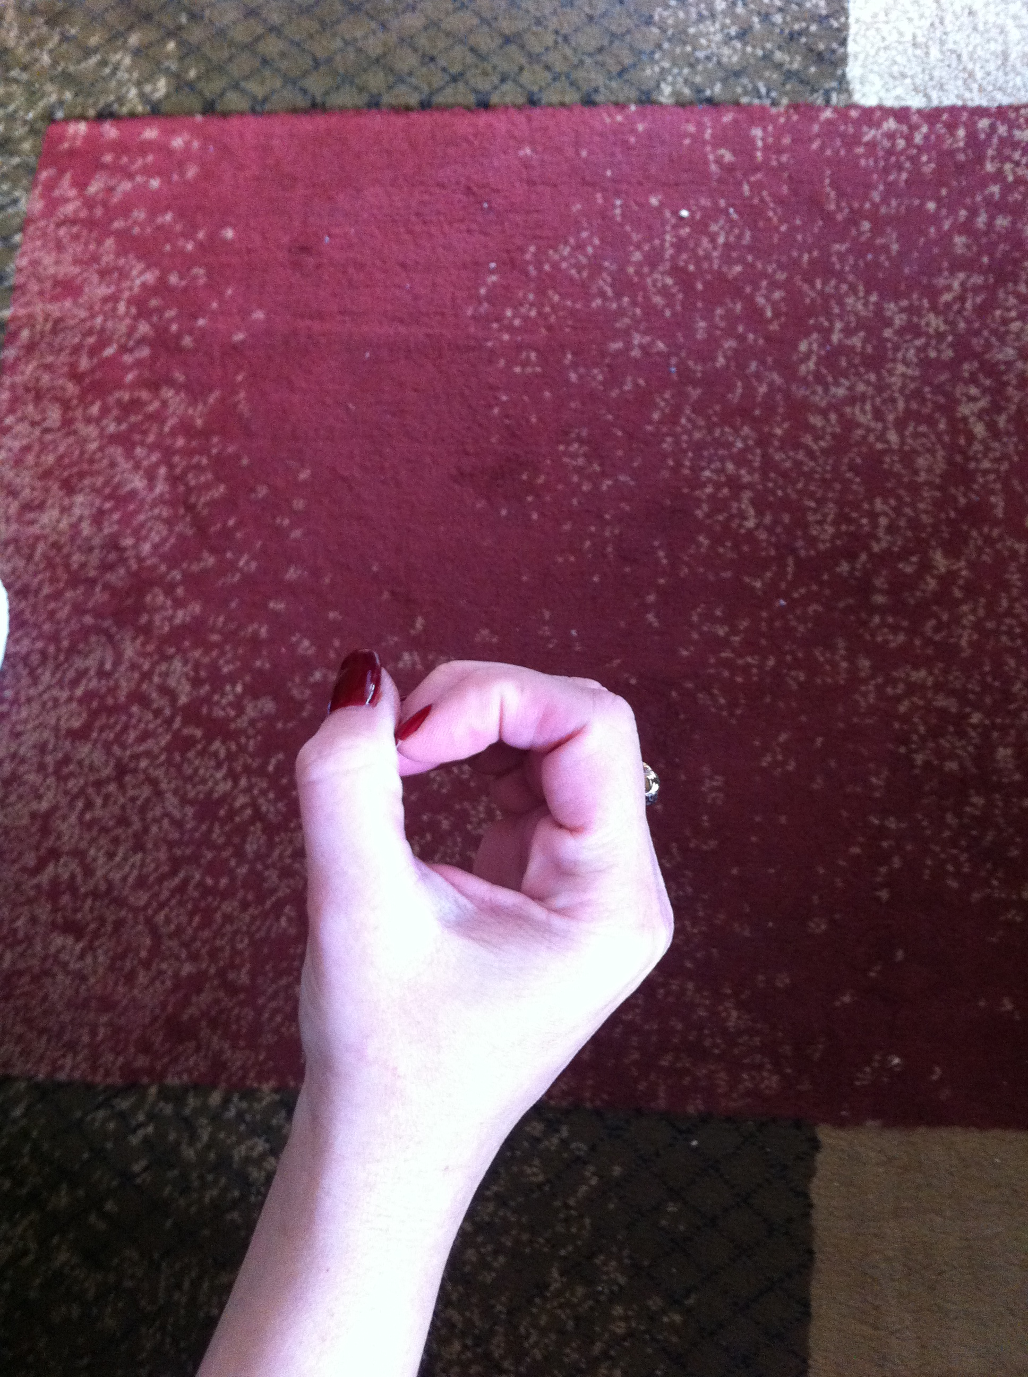
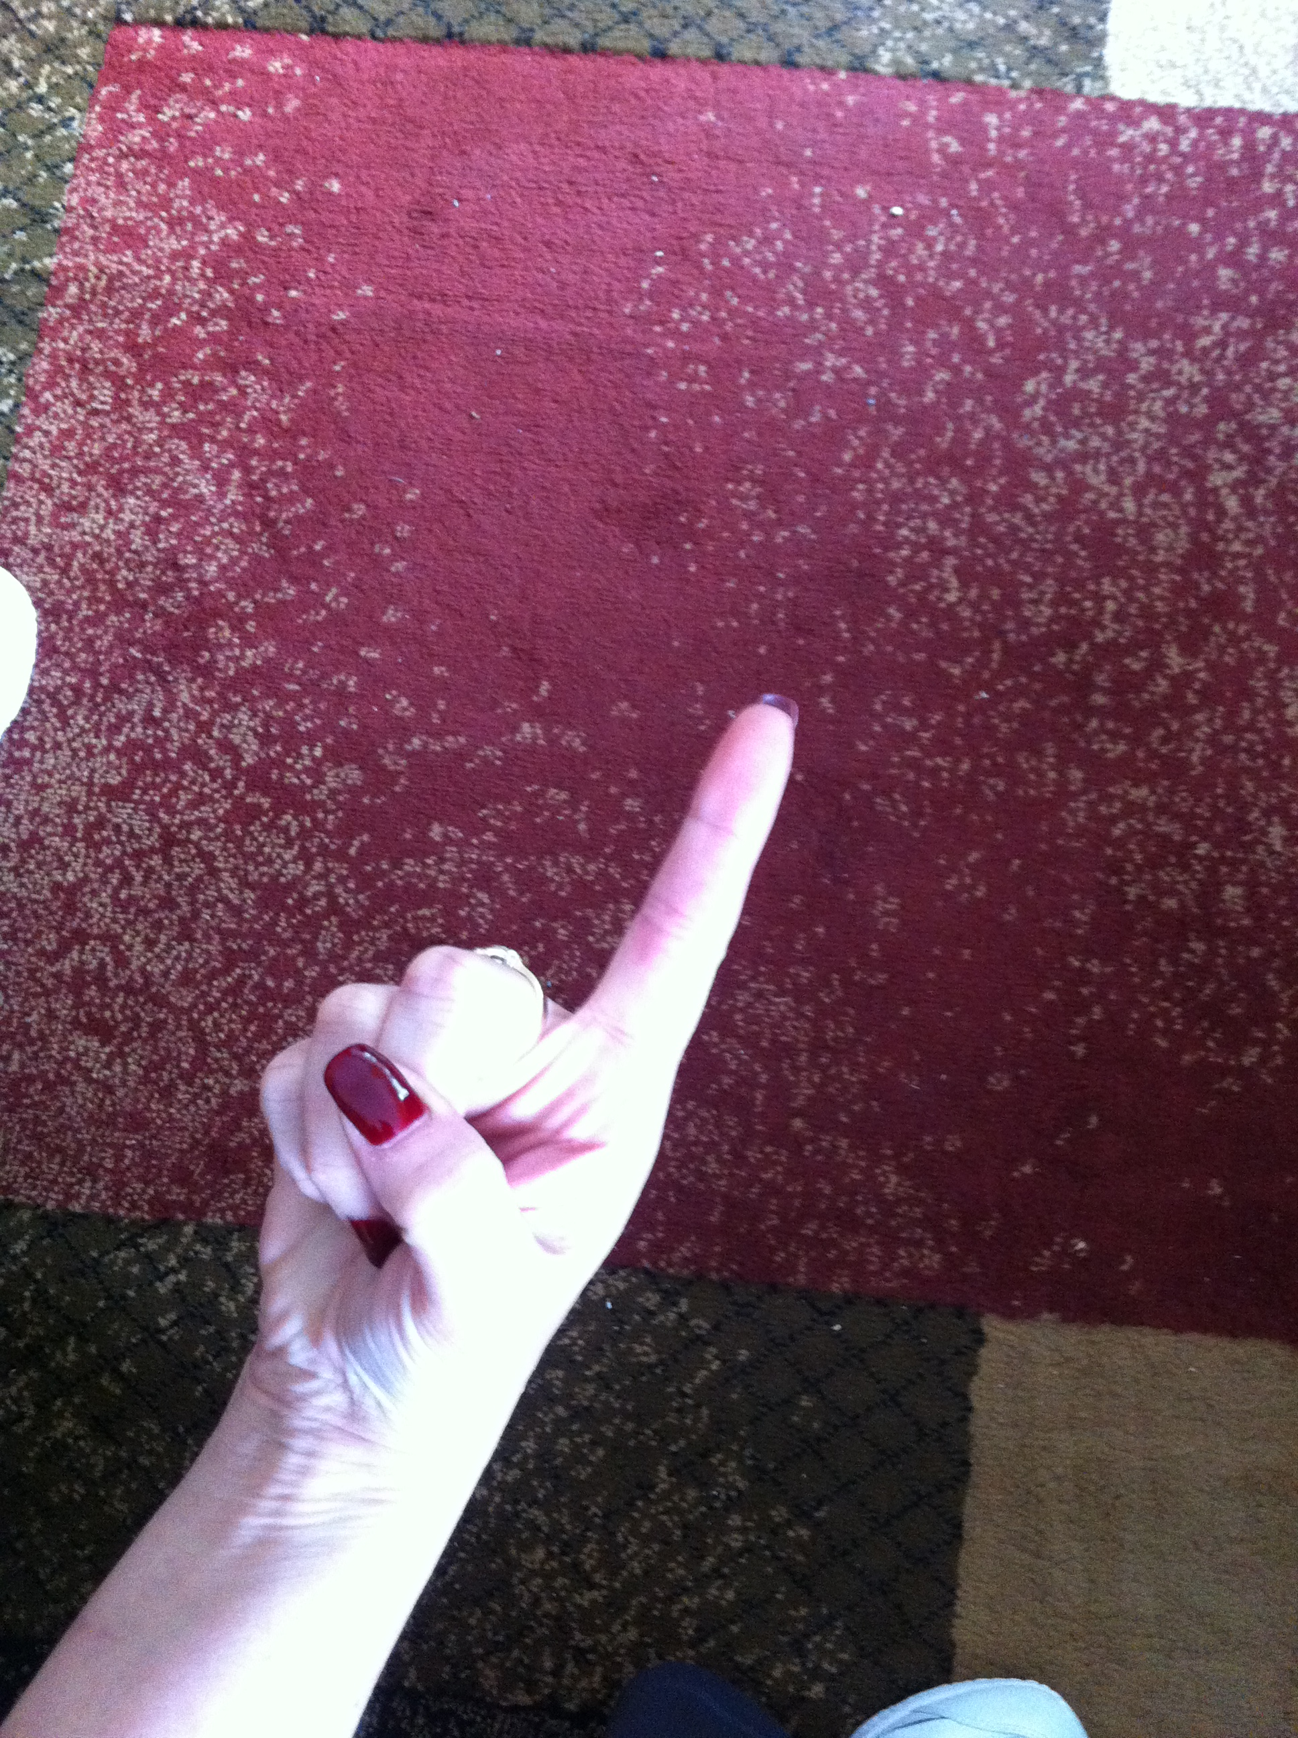





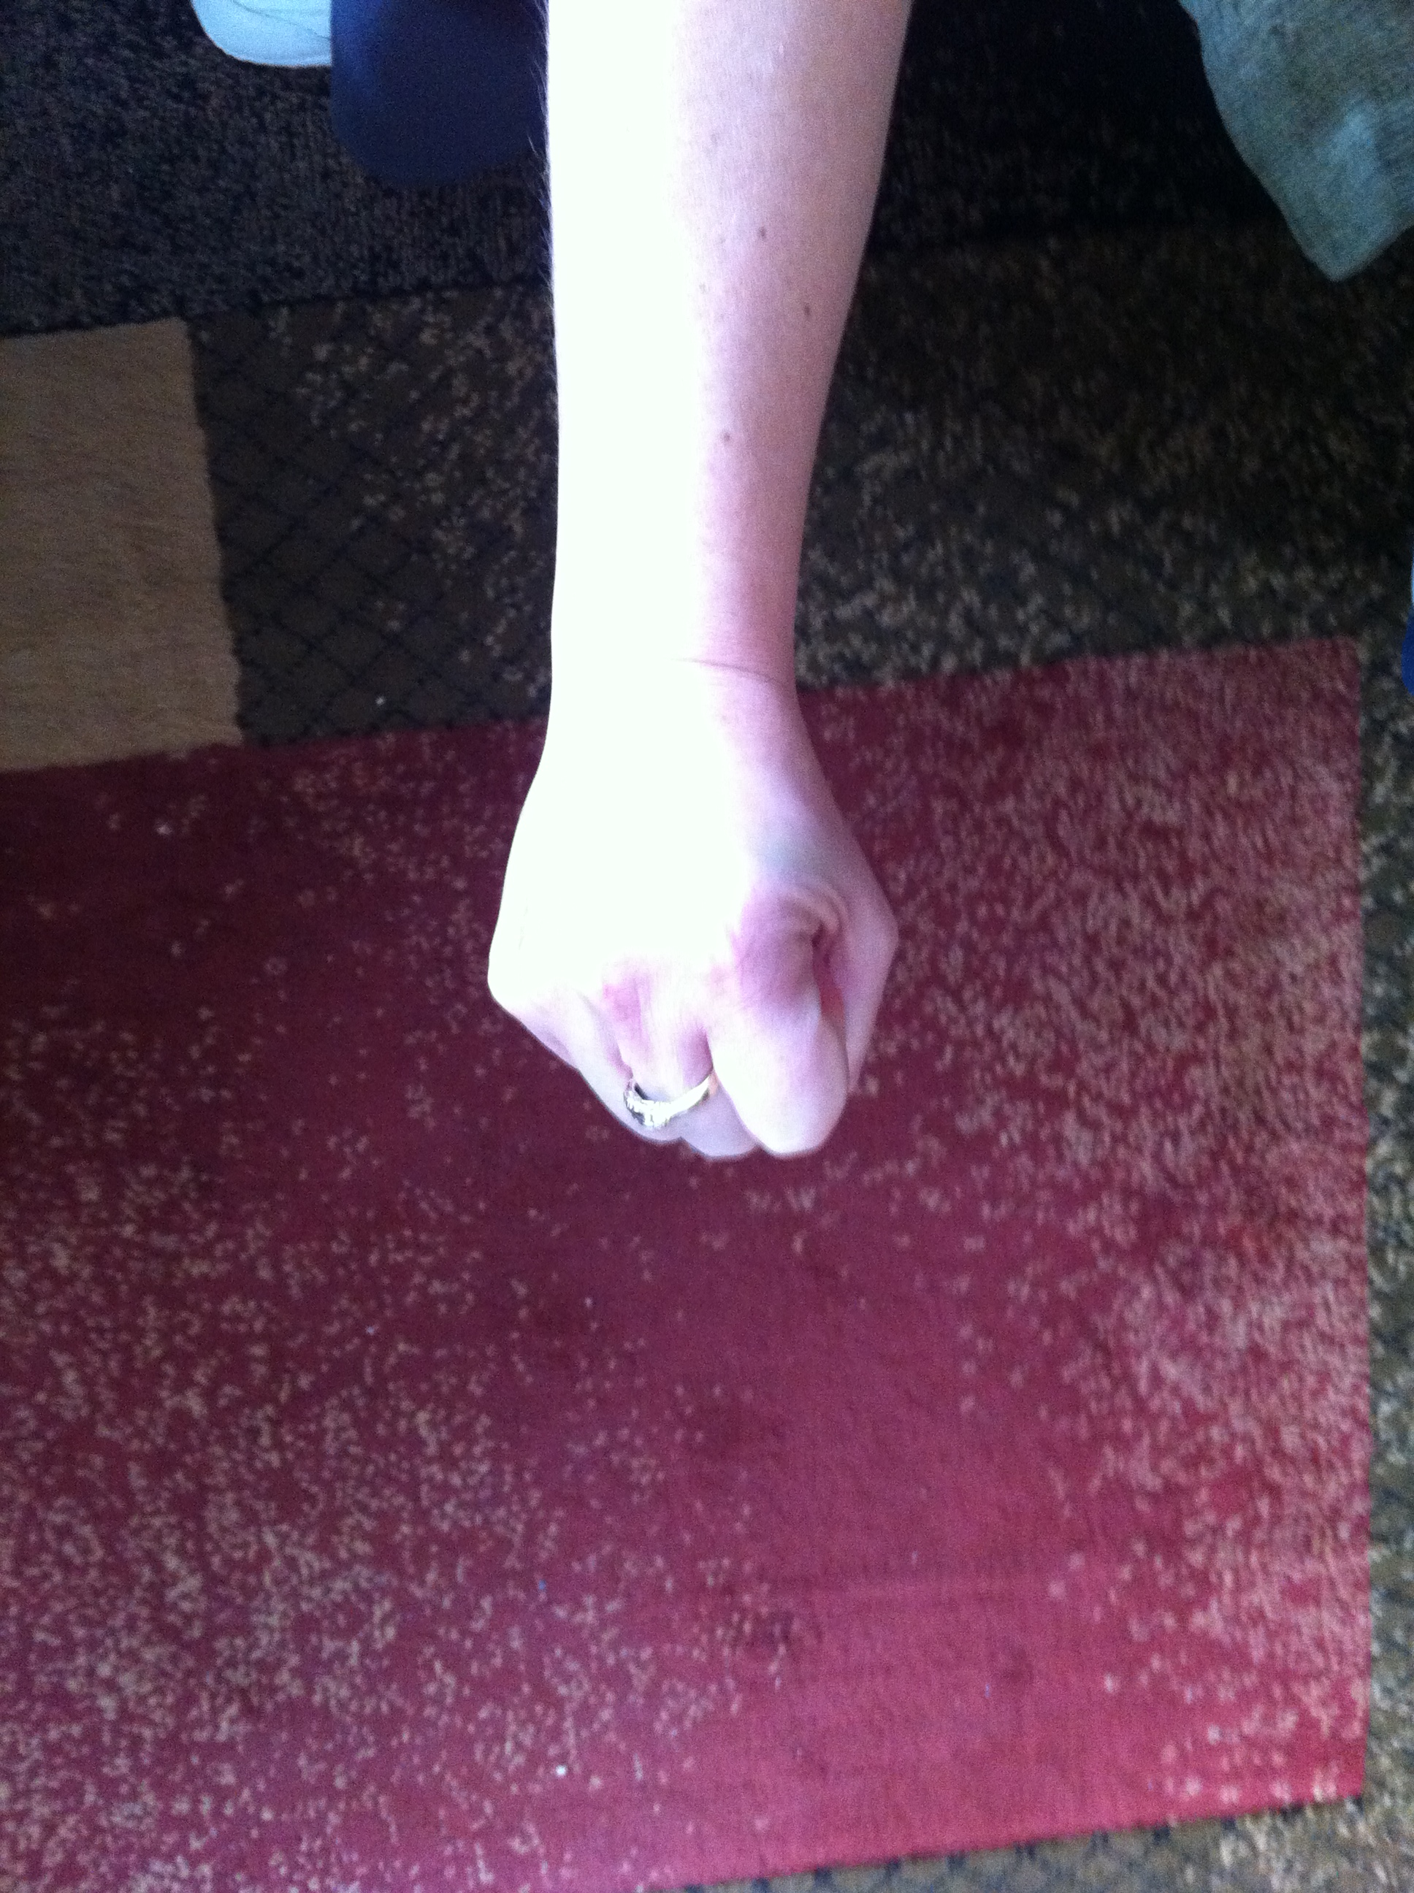
Agile Estimation: Thrown Estimates
Zero
1
2
3
5
8
10
Don’t know

Slide 43
Agile Estimation: Thrown Estimates
10 often means “too big” or “too many unknowns”
Discuss the unknowns
Individuals without much knowledge can abstain
Re-throw
Notes:
This variation is one that we have used. We throw 1, 2, or 3 as valid estimates. 5 is NOT a valid estimate and means “I have no idea”. If someone throws that then we need to have a conversation.
Teams may have their own variations on this. Sometimes people can abstain by throwing “rock” (a fist).
Note: demonstrate to them the counting in strategy you will use! “One, two, three, throw!”
From Martin Fowler’s website: http://martinfowler.com/bliki/ThrownEstimate.html

Slide 44
Agile Estimation: Thrown Estimates
Discuss only if there is disagreement
If everyone agrees, then there is no need to discuss
Discuss the unknowns – “Why do you think it’s a…”
Don’t try to convince people to change
Re-throw
Notes:
This variation is one that we have used. We throw 1, 2, or 3 as valid estimates. 5 is NOT a valid estimate and means “I have no idea”. If someone throws that then we need to have a conversation.
Teams may have their own variations on this. Sometimes people can abstain by throwing “rock” (a fist).
Note: demonstrate to them the counting in strategy you will use! “One, two, three, throw!”
From Martin Fowler’s website: http://martinfowler.com/bliki/ThrownEstimate.html

Slide 45
Relative Sizing
Notes:
All stories are sized relative to each other.

Slide 46
story11
story6
story1
story12
story7
story2
story13
story8
story3
Est: 1
Story14
story9
story4
story15
story10
story5
Notes:
Lay all cards out
Find the easiest one [CLICK]
We give that a 1 [CLICK]
We compare the rest of the stories relative to the first (easiest one)
----------------------------------------------------------------------------------------------------------
Of course, at the beginning, we don’t know what our estimates or velocity are. So let’s look at how we get started.
We’ll begin by figuring out how to estimate – after all, we haven’t estimated any of these stories yet, as a team. So we begin by laying out all of our stories on the table. We look them all over, one by one, and try to find the story we all think is as easy as any other story. [CLICK]
Assuming that we’re using Fibonacci numbers, we’ll assign this story a one [CLICK], which is the lowest estimate. You might remember that we included zero in our set of numbers – that’s reserved for the case when we say “Oh – we got this work done when we were doing something else – there’s no effort here.”
So, now we’ve got a story that’s a one. We begin the process of comparing all of our other stories to this one. Is each story more difficult than this one? How about these other ones?
[NEXT SLIDE]

Slide 47
story11
story6
story1
story12
story7
story2
story13
story8
story3
Story14
story9
story4
story15
story10
story5
Notes:
Proceed by sizing the rest of the stories in relation to the 1st one and to each other
Now what do we do with them?
---------------------------------------------------------------------------------
As we proceed, we estimate each story based on how hard it is in relation to our baseline story.
When we’re done, each story has been estimated, all of them relative to each other.
This allows us to move on to the next activity…

Slide 48
Relative Sizing Tips
All stories are sized relative to another
Sort out the stories and find the smallest
Size all other stories relative to that one.
Twice as big, three times as big, etc

Slide 49
Relative Sizing Stories
Split into groups of no more than 6 people
Using the stories of fruit handed to you
Size the stories relative to each based on….
The effort it would take you to eat the fruit
Note any assumptions you are making
Notes:
Mango
Orange
Cantaloupe
Pineapple
Pomegranate
Grape
Kumquat – about the size of a grape
Kiwi
Cherry
Apple

Slide 50
Estimation Approaches

Slide 51
Story Points
Effort, complexity
Relative to each other
Ignores time

Slide 52
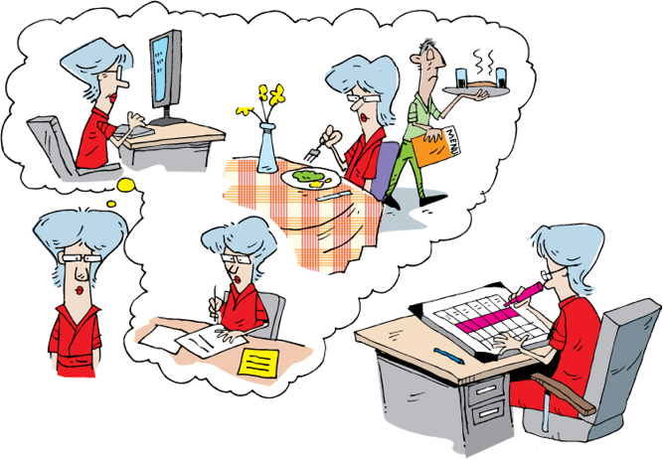
Time-Based Estimation
Notes:
Developers are asked to estimate the time to complete a story.
How do we consider other activities
Email
meals
Meetings
breaks
We use a concept called …..[Next slide]
---------------------------------------------------------------------------------------------------------
Now that we’ve talked about Fibonacci numbers and planning poker, let’s consider some other methods of estimating.
When doing time-based estimating, we are usually asked to provide the calendar time that it will take to complete the story. [CLICK] Each of us has to consider what other activities might occur during that time – whether it’s dealing with email, stopping for meals, or participating in meetings, [CLICK] or whether we take breaks to play computer games or live sports. Whatever it is that fills our time, we have to include not only the time spent on task, but also the time spent on other things. After all, we know that we don’t spend all of our time focused on the task at hand.
The problem with this is that when we’re putting together a classic project plan, we can’t factor in people’s work habits.
In order to address this, some folks doing Agile estimate using [NEXT SLIDE]

Slide 53
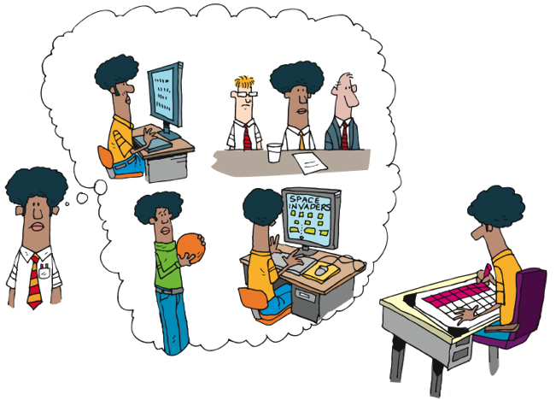
Time-Based Estimation
Notes:
Developers are asked to estimate the time to complete a story.
How do we consider other activities
Email
meals
Meetings
breaks
We use a concept called …..[Next slide]
---------------------------------------------------------------------------------------------------------
Now that we’ve talked about Fibonacci numbers and planning poker, let’s consider some other methods of estimating.
When doing time-based estimating, we are usually asked to provide the calendar time that it will take to complete the story. [CLICK] Each of us has to consider what other activities might occur during that time – whether it’s dealing with email, stopping for meals, or participating in meetings, [CLICK] or whether we take breaks to play computer games or live sports. Whatever it is that fills our time, we have to include not only the time spent on task, but also the time spent on other things. After all, we know that we don’t spend all of our time focused on the task at hand.
The problem with this is that when we’re putting together a classic project plan, we can’t factor in people’s work habits.
In order to address this, some folks doing Agile estimate using [NEXT SLIDE]

Slide 54
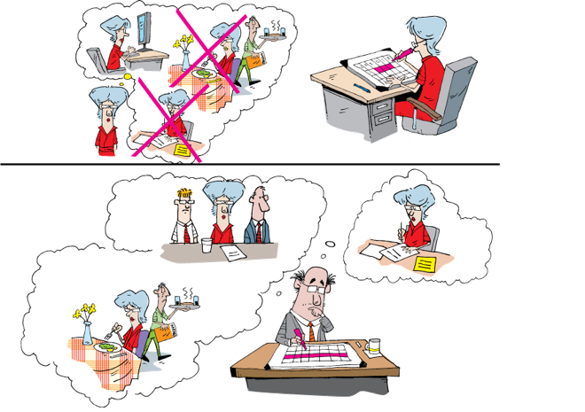
Ideal Time
Notes:
Ideal time
Time actually spent on completing the task
Includes testing and refactoring
Eliminates the interrupts and so forth
Assumes the average pair on the team
No factors for speed or expertise
------------------------------------------------------------------------------------------------------
…what is referred to as Ideal Time. Ideal Time can be defined as the time actually spent on task with a constant overhead factor applied.
That is, let’s say that I think a task will take me twelve hours to complete. That’s not really one-and-a-half days, because I do have to attend meetings and deal with interrupts and so forth. My project manager, in calculating the actual effort, will apply a multiplier – let’s say 100% - and therefore schedule twenty-four hours for this task.
The value of Ideal Time is that it allows the people doing the estimating to answer the question “In the ideal scenario, in which I do nothing but work on this task, how long would it take?” It takes out the interrupts and distractions on an individual basis, and adds them as a constant multiplier that applies to all.
This still doesn’t deal with variations on speed and expertise, unfortunately. That’s why we prefer to use relative units like Fibonacci numbers.

Slide 55
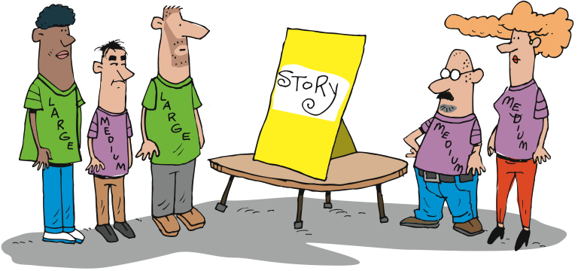
Granularity of Estimation
Notes:
T-shirt sizing is sometimes used as a starting point
Will need to be translated to time at some point
Helpful when thinking about a new module or initially sizing a project
----------------------------------------------------------------------
Another simple method of relative estimation is T-shirt sizing. The simplest is to estimate each story as small, medium, or large. You can include extra small, extra large, and extra extra large if you like. Any system that estimates stories relative to other stories will work.

Slide 56

Spikes
Solve hard technical problems through real experiments… without tampering with production code
Notes:
Time boxed
Throw away
Done during inception, but typically environments are set up yet
Done during Iteration 0, but initial estimate has already been given

Slide 57
In Summary
Accuracy and Precision
Estimating Systems – Fibonacci Sequence
Planning Poker
Ideal Time
Calculating Raw Velocity
Spikes

Slide 58
Release Planning
Notes:
We have stories
We have estimated the stories
We know about how much work we can get done in an iteration
We know about how many iterations we have
Now we need to put the stories into Releases
Now that we’ve talked about stories and roles and personas and low-fi prototyping and storyboarding – that is, the tools and artifacts that enable us to know what we’ll be building - let’s talk about how we do our planning and communicating.

Slide 59
Why plan?
Expectation setting
Focus on business value
Goals and milestones
slide 59
Notes:
59
Helps set expectations about the execution of the project
Provides a focus on the business value/outcomes to be realized
Gives the project team a set of goals and milestones
Low: 1 min
High: 3 min

Slide 60
Questions To Be Answered
What are you going to build?
In what order?
How long is it going to take?
How much will it cost?
What roles and how many do we need?
What else do we need to do?

Slide 61
Release Success Criteria
Quantifiable business objectives
ROI
Time
Budget
Scope
Notes:
What is driving the Release?
Time, budget, scope
Market pressure for functionality
Launch of a new project
Are there quantifiable objectives / ROI that need to be met?

Slide 62
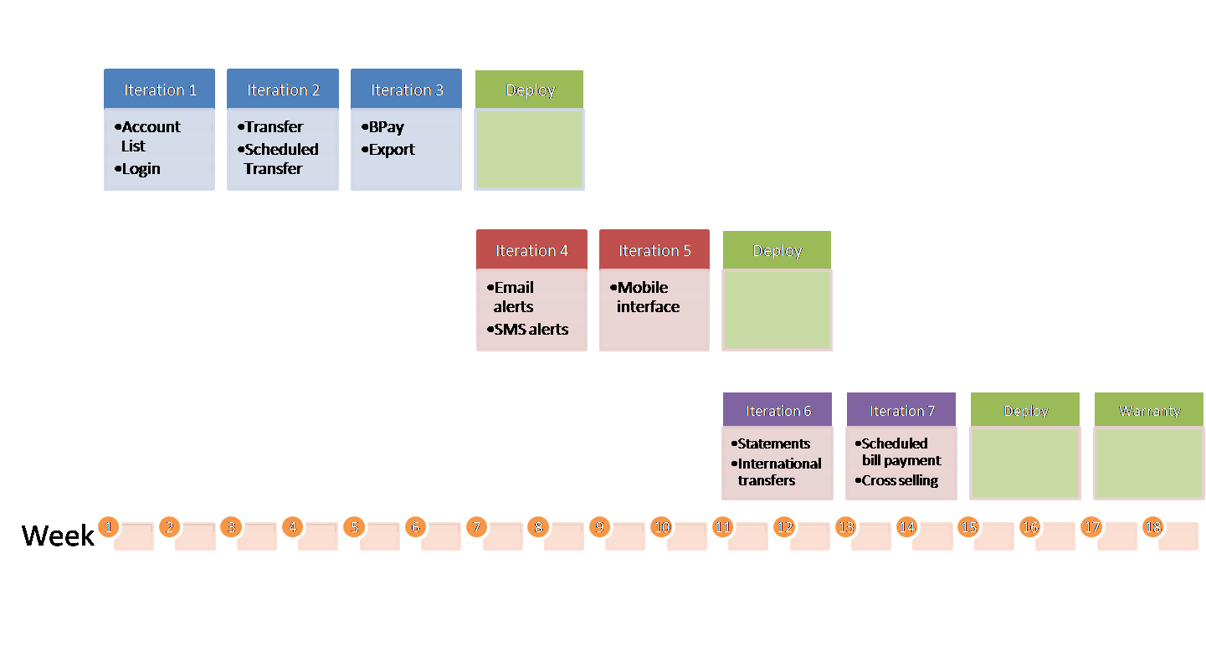
The Release Planning Inputs
Release Planning
Development Capacity (Velocity)
Release Success Criteria
Master Story List
Release Constraints
Dependencies
High level tech architecture
Cross Functional Requirements
Notes:
We need to understand the:
Release success criteria. Time driven, scope driven, $ driven.
Development capacity
Constraints - resource, technical, skill level
Project dependencies
A high level application architecture
Non functional or cross functional requirements – all the ‘abilities
----------------------------------------------------------------------------------------------------------
Like most things in an Agile world, release planning is an iterative and adaptable process. Depending on how the first cut at a release plan may look, more effort may be put into loosening the hold of external constraints (e.g., marketing schedules) or the success criteria for the release may be re-examined (e.g., perhaps another pass through MoSCoW on the story list).
Development Capacity can either be estimated (using a sampling of different story sizes and extrapolating) or determined using a spike iteration.
The success criteria for the project are probably enumerated across the lines of scope (e.g., “we must have these features at least”), cost (e.g., “we only have budget for $200 of development”) and time (“we need to get something to market before the conference starts”).
External constraints can have a big influence on the release plan and are often in the shape of project dependencies (i.e., integrating with Application X which only releases each quarter).
A release story wall can be used to show the distribution of stories between releases and between iterations within a release. Obviously a release plan is a high level artifact, so the expectation should be set to allow considerable movement at this level.
Low: 2 min
High: 5 min

Slide 63
What?

Slide 64
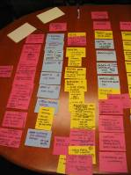
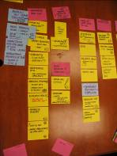
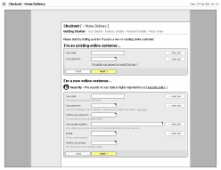
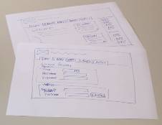
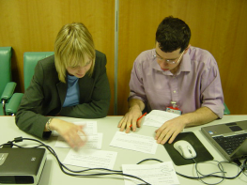
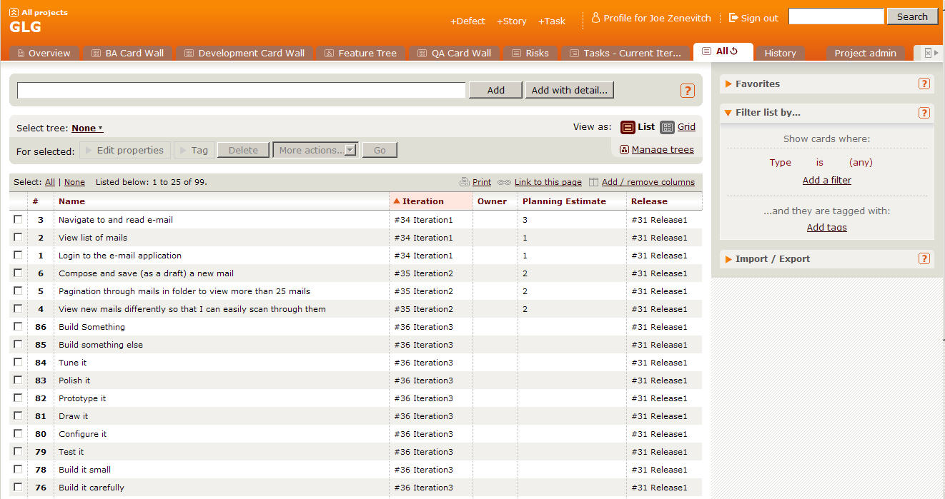
Initial Story List
As-Is & To-Be Process modelling
Low fidelity prototyping
Focused small group analysis
Initial story list
Notes:
The story is the unit of work we will measure to determine approximate length and cost of project.
We conduct many workshops to create stories and ultimately the MSL.
We go in depth on each of these items and more to get to our initial story list.
Not shown here –
Roles/Goals, Personas, Scenarios, Contextual Inquiry results,
Low: .5 min
High: 2 min

Slide 65
MoSCoW Prioritization
Won’t Have
Could Have
POINTS
Should Have
Must Have
Notes:
Most likely the total bucket of stories will can be categorized into these four buckets. For the purposes of planning the first release, the MMR should be the Must Have bucket.

Slide 66
Identify MLM Totals
Won’t Have
Could Have
POINTS
Should Have
Max
Likely
Must Have
Min
Notes:
If you have done Min-Likely-Max estimation, you should be able to obtain these totals

Slide 67
Story Growth Allowance
Won’t Have
Could Have
POINTS
Should Have
Must Have
Notes:
If you have done Min-Likely-Max estimation, you should be able to obtain these totals

Slide 68
Unknown Story Allowance
Won’t Have
Could Have
Should Have
POINTS
Must Have
Allowances will most likely be required, they are not “nice to have”
Notes:
If you have done Min-Likely-Max estimation, you should be able to obtain these totals

Slide 69
Primary variables in developing a base release plan
The total new size of what we are developing (in points)
POINTS
TIME

Slide 70
Span Planning
Goal
Goal
Goal
Activity
Activity
Activity
Activity
Time
Story
Story
Story
Story
Necessity
Story
Story
Story
Story
MMF
Story
Story
Story
Story
Story
Story
Notes:
There are many versions of this approach, but in essence its about laying out the stories so that you can see where the MMF is.
The next slide shows an example from Jeff Patton
When prioritizing stories and building the Release Plan, consider the following:
Business Value – does this contribute to the ROI. What is the Minimum Marketable Feature set?
Risk – does the item carry either technical or functional risk
Usage – How often is this feature set used and by how many different roles/personas?
Compliance – is the feature set required to avoid possible financial penalties?
Dependencies - is this feature set dependent on or required by another team?
Simplicity – do we need all parts/stories for this feature set? Or can we go Live with a subset?

Slide 71
How much can we do?
Notes:
Low: 1min
High: 3min

Slide 72

Velocity
Notes:
Now we need to figure out how fast we think we can work
Initially it’s a guess. Experience makes our guesses more accurate and precise.
Velocity – the amount of work that we can complete in an iteration
-----------------------------------------------------------------------------------------------------------
Once we’ve figured out how difficult each of our stories is, then we need to figure out how many we can fit into an Iteration. That’s what we call velocity – the amount of work, computed based on our estimates, that will fit in an Iteration.

Slide 73
How to Derive a Planning Velocity
Trial Iterations
Educated Guess
Experience
Velocity Planning Games
Accuracy
Effort/Time
Notes:
The line represents project start.
Educated guess using data from previous projects is risky. You must determine the variables that were in play on the other project(s) compared to this project.
Trial iteration. Costly, but most accurate for planning.
Velocity planning game. More risky. Likely to be modified.
---------------------------------------------------------------------------------------------------------------
Experienced Agile teams will set expectations for a fairly steady ramp up in velocity over time as the team forms and early uncertainties get ironed out. But the question remains – what planning velocity shall we ramp up to? As with all estimation activities, experience is an invaluable contributor but hard data is going to be the biggest factor, hence the option of using a trial iteration. As heavyweight as this sounds, taking just two weeks to provide a good set of real data for future planning over the course of a 20 week project is probably not a bad investment.
For people looking for a cheap way of obtaining a planning velocity, do be wary of using an data from previous projects, even with the same group of people. As easy as this may sound, there are so many variables unaccounted for that any planning you do is really little more than an educated guess.
Low: 1 min
High: 3 min

Slide 74

Velocity Planning Game
Devs select cards they think a pair can get “done” within an iteration
Facilitator tallies up the total (secretly)
Facilitator lays out sampling of stories
Team should decide in advance on:
Length of iteration
Definition of “done”
After a min of 10 iterations, look for convergence
Notes:
Low: 2 min
High: 4 min

Slide 75
5
3
8
1
2
2
2
3
3
5
1
8
Notes:
We take our estimated stories [CLICK]
…something we call the Raw Velocity Game.
In the Raw Velocity Game, the goal is to estimate our initial “raw” velocity, so that we can know how many stories to choose for our first Iterations.
We start with all of our stories [CLICK] and their estimates. Then we cover all the estimates [CLICK].

Slide 76
5
3
8
1
2
2
2
3
3
5
1
8
Notes:
We cover up the estimates
We take a random sample of cards and lay them out
We ask the developers which cards they feel could be done in 1 iteration
We calculate the total
We repeat
We average
The team now examines all the stories and chooses a set to answer the question “Pick a set of stories that you think you can get done in one iteration.” The idea is to pick just enough stories to fill an iteration, without overfilling it.
Once the team has picked some stories… [CLICK] pause [NEXT SLIDE]

Slide 77
3
5
8
1
2
2
2
3
Round one: 8
3
5
Round two: 11
Round three: 9
1
8
Average: 9
Notes:
We calculate the total
We repeat
We average
Gives us a starting point
Adjusted throughout the project
Assume lower velocity at the beginning of a project
Team needs to jel
Things the impact velocity
Technology
Delivery model
Team size
Full time/part time devs
----------------------------------------------------------------------------------------------------------
… we reveal the estimates [CLICK] and total them up. [CLICK]
We then repeat this process two more times, getting the team’s best guesses [CLICK], and we average all three rounds [CLICK].
The resulting number – nine in this example – gives us our initial, raw velocity. [CLICK] We’ll use this number to determine how much work we think we can get done in our first few iterations.

Slide 78
Velocity Planning
Get back into your groups
Using the estimates of the fruit you came up with
How much fruit could you eat in 3 minutes?
Notes:
Mango
Orange
Cantaloupe
Pineapple
Pomegranate
Grape
Kumquat – about the size of a grape
Kiwi
Cherry
Apple

Slide 79
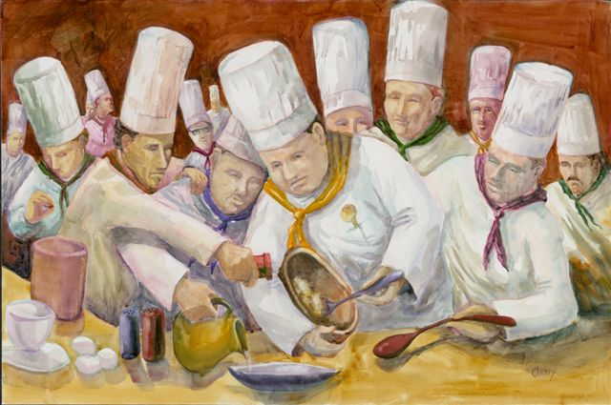
How Many Pairs?
Unfortunately this is often more art than science
But, it will probably be influenced by:
Availability
How many different feature sets/subsystems there are
How many points in the total
Gut feel – “too many cooks in the kitchen”
Notes:
Insert activity here
Without activity:
Low: 1 min
High: 3 min

Slide 80
How long?

Slide 81

How many iterations?
As a user I need to blah blah so that blah
4
2
Story Point Estimates
As a user I need to blah blah so that blah
As a user I need to blah blah so that blah
4
As a user I need to blah blah so that blah
2
Estimated Iteration Velocity
As a user I need to blah blah so that blah
1
As a user I need to blah blah so that blah
8
User Stories
(Points per iteration)
Total Story Points
/ Estimated Velocity
= Number of Iterations
Notes:
Need to answer the questions of:
How long will it take?
How much will it cost?
Other things can impact velocity, like ramp up, scheduled absences, etc, and should be factored in the plan
Low: 1 min
High: 3 min

Slide 82
Raw Velocity
Estimated Velocity Per Pair X Steady State Pairs = Raw Velocity Per Iteration
POINTS
TIME
Total Story Points / Raw Velocity Per Iteration = Rough Number of Iterations

Slide 83
Velocity Adjustment - Risk
Calculate with lower end of the velocity estimate, or to account for risks
POINTS
TIME

Slide 84
Velocity Adjustment – Ramp Up
Account for the team (as a steady-state whole) will take a couple of iterations to get up to full (estimated) velocity
POINTS
TIME

Slide 85
Velocity Adjustment – Onboarding
Depending on size of team, not all developers may start on the first day. May need to adjust further to match velocity to onboarding.
POINTS
TIME

Slide 86
Velocity Adjustment – Time Off
Make adjustments for known vacations, holidays, business closings, special events
POINTS
TIME

Slide 87

Other Adjustments
Technical Analysis
Performance Testing
Dependencies
Problem Resolution
Testing
Offshore?
CFR’s
Story Volatility
Confidence Levels
Build/Environments
Skill Levels
Notes:
Insert activity here
Without activity:
Low: 1 min
High: 3 min

Slide 88
Development Duration Range
The intersection of the story point and velocity lines gives you your development duration range
POINTS
TIME

Slide 89
Add Non-Dev Time
Add whatever time is necessary on either end, and you have your total estimated duration range
UAT
Beta
GA
Initiation
UAT
Beta
GA
POINTS
TIME

Slide 90
Other

Slide 91

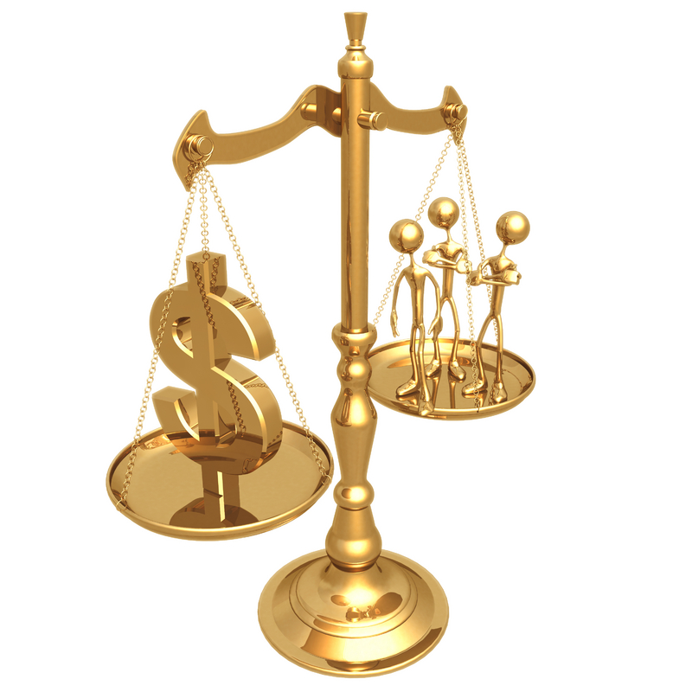

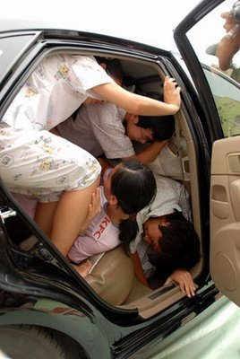

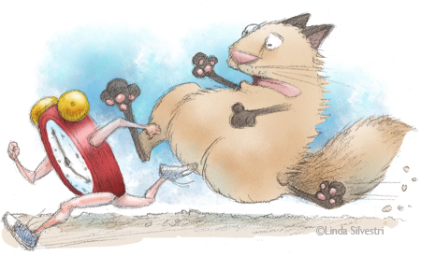
What Are Your Constraints?
Quality?
Scope?
Resources?
Budget?
Time?
Scheduling?
Notes:
Unconstrained Model
Tell us how long it will take to build this
Constrained Models
Tell us what we can build and stay within budget
Tell us how long it will take to build this with the staff we have
What can we get built in a certain timeframe
A time constrained project is one where the first release must be delivered by a certain date
A resource constrained project is where for whatever reason you can’t add more people, which could be because there is a budget constraint
But, budget could also be a constraint on how long the team can work for
A scope constraint is where a certain scope must be delivered for some reason (perhaps compliance reasons)
Low: 2 min
High: 5 min

Slide 92
Dependencies
Cross project dependencies
Departmental dependencies
Staffing dependencies

Slide 93
Cross-Functional Requirements
Execution
Evolution
Auditability
Authentication
Authorization
Availability
Performance
Regulatory
Security
Portability
Extensibility
Localization
Scalability
Usability
Notes:
Another type of requirement that has to be captured on all projects is the NFR.
We all know what these are. They creep up on us near the end.
Execution qualities of a system – security, usability
Evolution qualities – testability, extensibility, scalability
NFRs are typically technical or usage based and usually follow policy or documented guidelines
Make them cards.
Its work you have to do.
HAVE SOME DISCUSSION HERE as to what you can do about these.
Technique-
Send out a questionnaire first for folks to do their homework.
How many transactions/users/countries/whatever?
Response time?
What platforms?
Compliance
Low: 5min
High: 15min

Slide 94
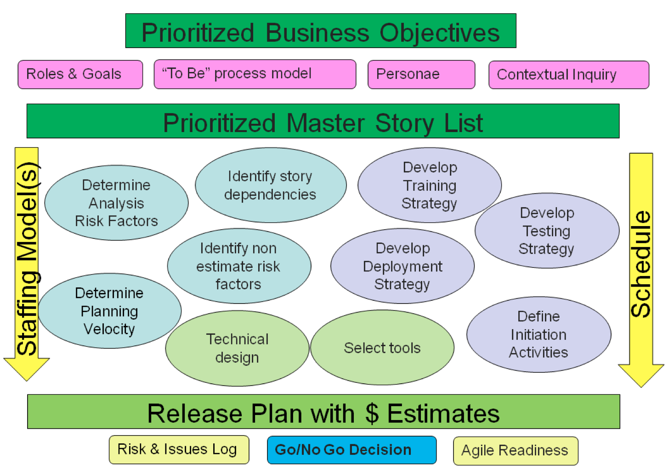

Slide 95
In Summary
Prioritizing stories
Minimally Marketable Features
Span Planning
Other activities

Slide 96
Managing the Work
Notes:
We’ve planned our project into Releases and we are ready to get started.
How to manage the everyday
Some of this you’ve seen in previous modules
----------------------------------------------------------------------------------------------------------------
So now that we know what we’re going to build, and in what order, we have to figure out how to make sure that everything flows nicely through the process.
Much of what we’re going to talk about now has been covered in earlier modules. Since it’s important to have a firm understanding of these things, we’ll go over them again here.

Slide 97
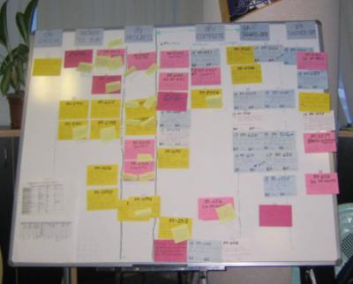
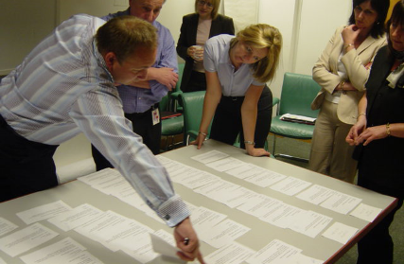

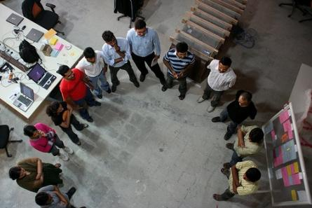
Four Key Agile Meetings
Iteration Planning
Release Planning
Stand Ups
Retrospectives
Notes:
3 of these meetings can be done distributedly.
We discourage distributed Release Planning.
Mountain goat software has distributed Planning Poker.
Ideaboardz and Edistorm are good for distributed Retrospectives.

Slide 98
The life of a story across iterations
I0
I1
I2
I3
Planning
Planning
Planning
Elaboration
Elaboration
Elaboration
Build
Build
Build
I1 Activities
UAT Test
UAT Test
UAT Test
I2 Activities
Regression Test
Regression Test
I3 Activities
Notes:
For many people accustomed to single activity workflows, understanding the dynamics of an iterative project can be challenging. This diagram attempts to make a clear statement about the timing and nature of activities being conducted at any one time. The items of the same color are all activities required for a single development iteration, which requires planning and story elaboration (in the previous iteration), development and UAT (in the current iteration) and then regression testing (starting in the subsequent iteration.
And this set of tasks overlap for each iteration, so that at any point in time (looking down a vertical slice of the diagram), planning will be being done for the next development iteration, development and UAT will be in progress for the current development iteration and regression testing will be conducted for the previous development iteration.
Low: 1 min
High: 3 min

Slide 99
A sample iteration schedule
Week 1 … Week 2
Stand-up
Stand-up
Stand-up
Stand-up
Stand-up
Stand-up
Stand-up
Iteration
Kickoff
Design
discussions
Analysis meetings
Development
Analysis
Analysis meetings
Design
discussions
Showcase
Prep
Development
Analysis
Development
Analysis
Development
Analysis
Development
Analysis
Development
Analysis
Showcase
Retrospective
Iteration
Planning
Wednesday
Thursday
Friday
…
Friday
Monday
Tuesday
What’s missing?
Notes:
Rookie error to start iteration on Monday. Too many holidays.
No standup on first morning of iteration
Glaring omission is ongoing testing
2 – 4 weeks is a normal length.
It’s a rookie error to start an iteration on Monday and finish it on a Friday. After all, it seems logical given the natural week boundaries. However, the number of public holidays that eat into Friday and Mondays can cause major headaches when it comes to re-scheduling showcase meetings and the like.
This schedule shows a common pattern of no standup on the first morning of a new iteration. As everyone’s context has switched since the end of the previous iteration, there’s normally very little continuity and makes stand-ups on these mornings of little value, especially once a team is up to speed.
The one glaring omission from this diagram is the ongoing testing effort required by the QA people. They will be doing spot inspections, regression testing and (possibly) automation for the majority of the iteration whilst development and analysis is going on.
Two to four weeks is a normal length for an iteration. It is a nice balance between setting a regular pace for the team and having enough time to deliver something demonstrable. If you feel the need to consider a longer iteration because the requirements are simply too big to get done properly within 2 weeks, then the size of the requirements is almost definitely the issue, not the size of the iteration.
Low: 2 min
High: 4 min

Slide 100
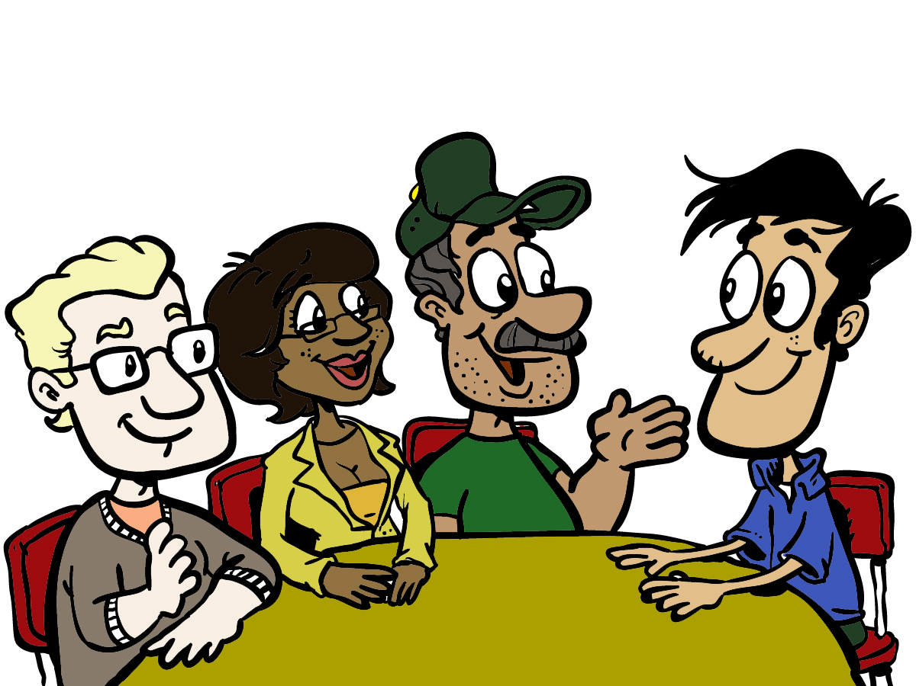
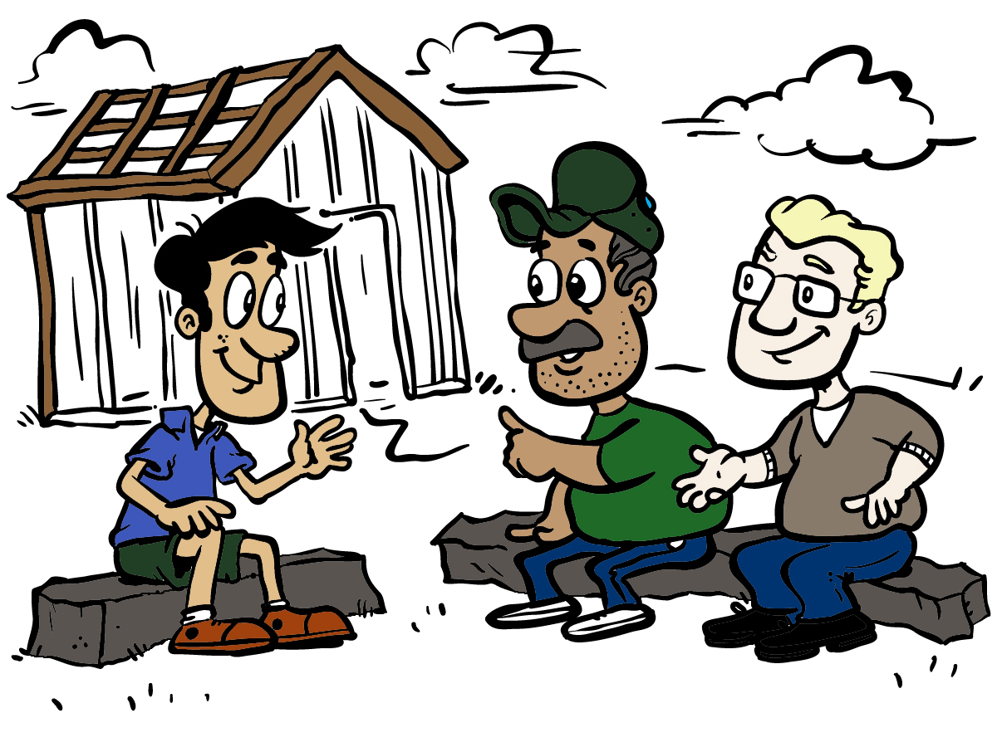
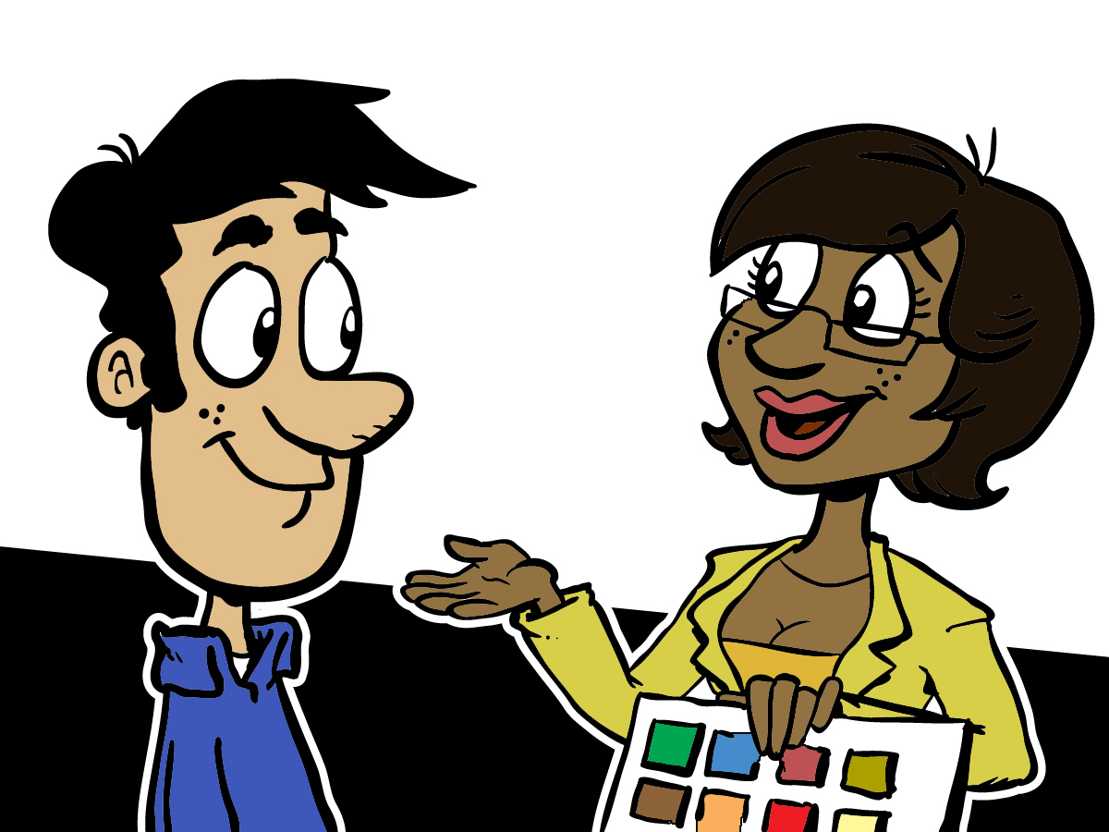
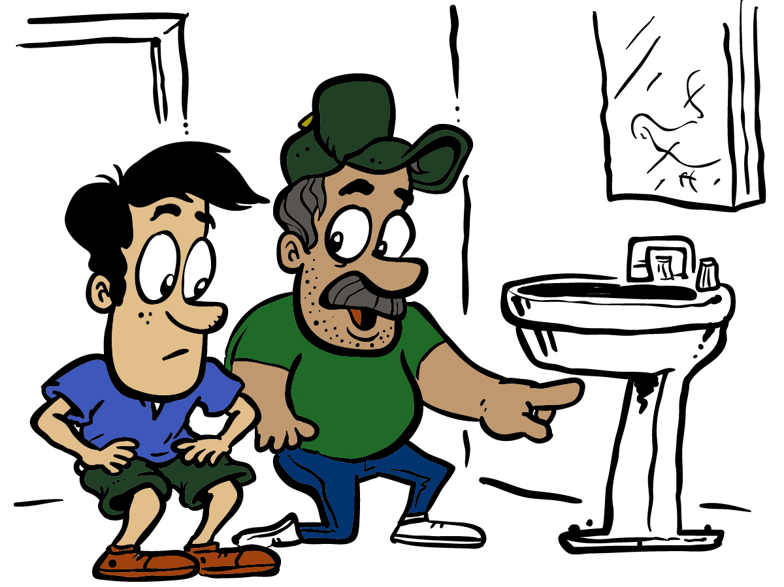
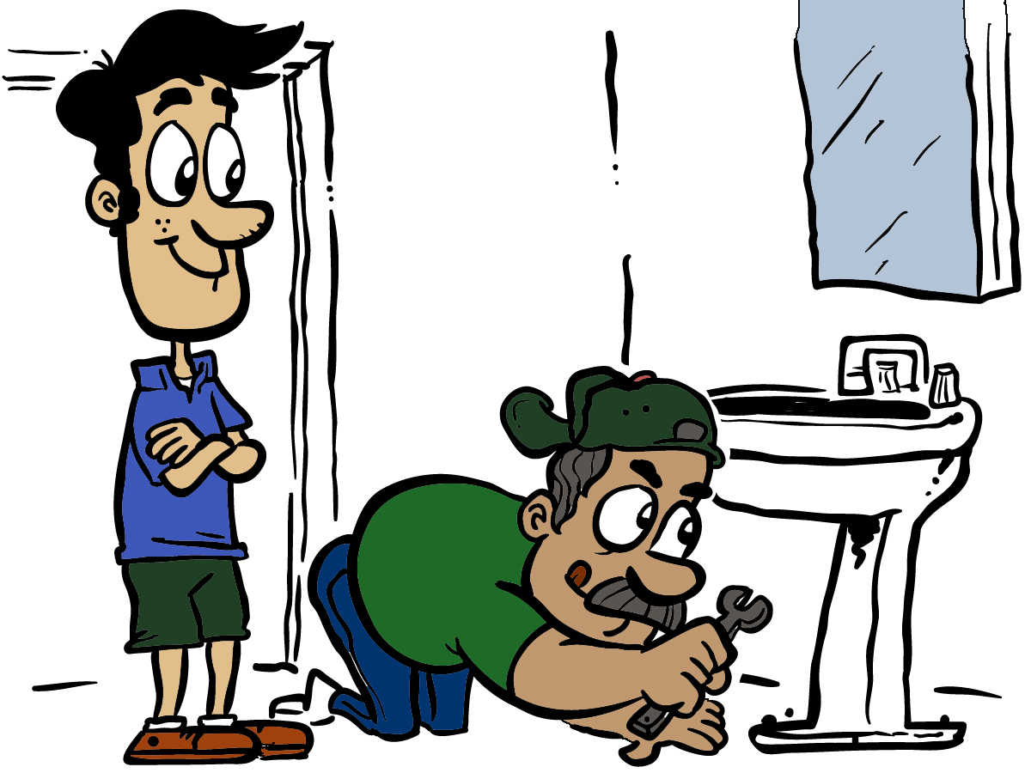
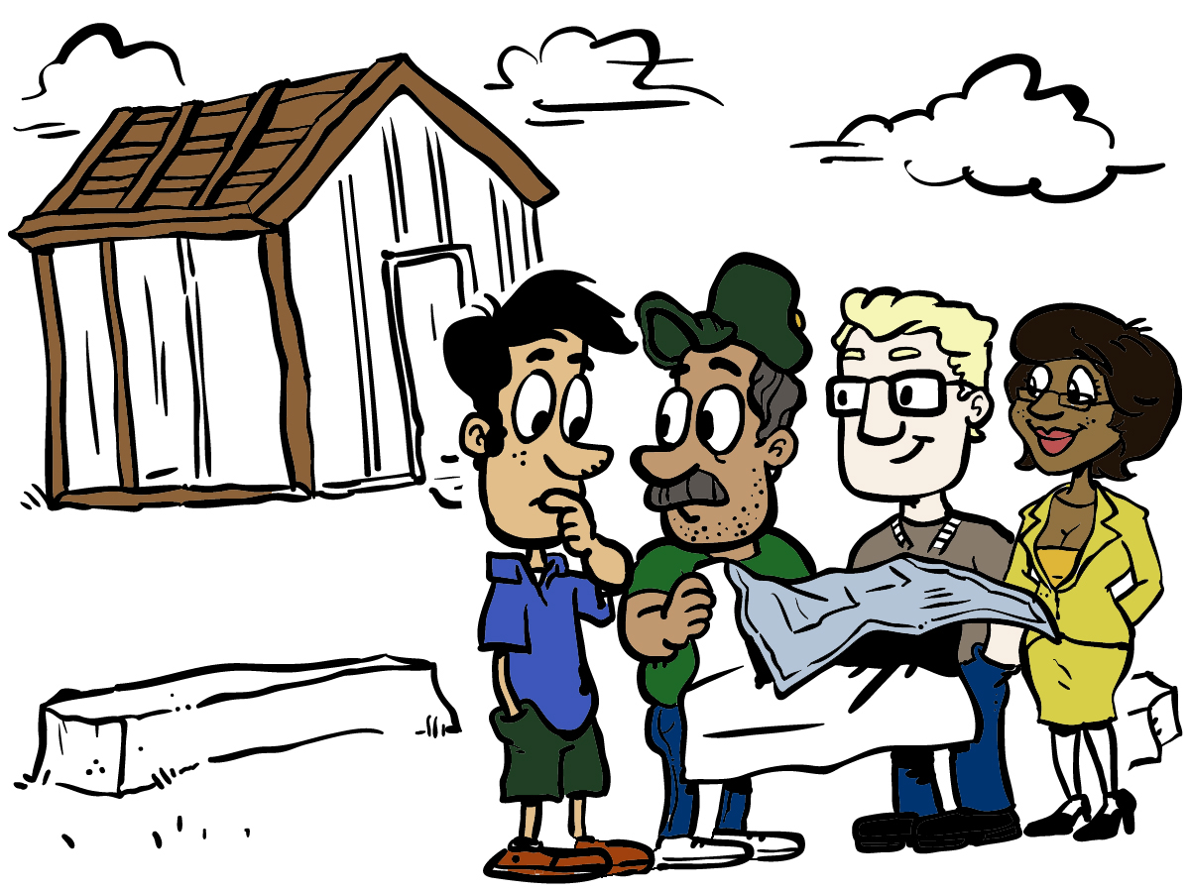
Iterative and Incremental
Notes:
Iterative
Define a set of steps and do them repeatedly.
Lather, rinse, repeat
Analyze, design, build, test, show, review, improve
Incremental
Adding more each iteration
-------------------------------------------------------------------------------------------------------------
In the Module “The Agile Core,” we talked about the fact that Agile, by nature, is iterative and incremental. To make sure we have a shared understanding of those terms…
By “iterative”, we mean that we define a set of steps, and then we do that set of steps repeatedly. Like the instructions on a shampoo bottle – “lather, rinse, repeat”. We figure out what works for us, and then we do that repeatedly. Of course, we’re constantly examining and re-evaluating what we’re doing, looking for ways to improve.
By “incremental,” we mean that with each iteration – each timebox of effort and product – we add something more to the functionality and value of the thing we’re building. We don’t define how “big” the increment is, we just make sure that each time around, we’re delivering something more.

Slide 101
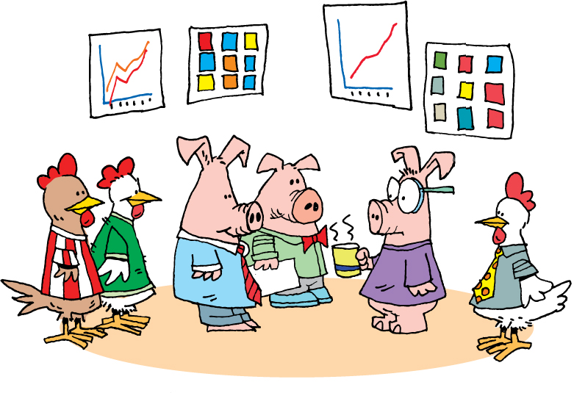
Daily Stand-Up
Notes:
Daily Scrum or daily standup
Chickens and pigs – who talks, who doesn’t
Held daily
Entire team
Answer 3 questions
What did you do yesterday?
What are you going to do today?
What obstacles or impediments are preventing you from making progress?
Short
Conducted by the card wall
Everyone stands
Keeps everyone informed
Not a status meeting
--------------------------------------------------------------------------------------------------------------
Whether you talk about Scrum – and call them daily scrums – or XP – and call them daily stand-ups – the concept is common to both systems. The idea is that the project team gets together daily, stands up, and each committed member of the team (the pigs) shares the answers to these three questions:
What did you do yesterday?
What are you going to do today?
What obstacles or impediments are preventing you from making progress?
Generally speaking, these meetings should be pretty short. Team members will frequently refer to stories by number or title, like “I completed number 421 yesterday and am going to start on number 437 today. I can’t get going until the database is set up.”
Since the card wall - whether physical or electronic - is readily available and visible, generally it’s easy for everyone to understand what is being discussed.
The meetings are held standing, because the goal is to keep them short. Anything that doesn’t fit easily into the answer to one of the questions is recorded and discussed at the end of the stand-up meeting. Chickens are generally not permitted to speak during stand-up, as what they have to say may be important and valuable, but is not a part of this particular meeting.
The daily stand-up, or daily scrum, contributes significantly to keeping all parties informed about what’s going on and what progress is being made.
The daily stand-up is not a status meeting. It is not an opportunity for everyone present to report to the project manager, scrum master, or anyone else. The daily stand-up is a chance for everyone to keep up to date with what is going on on the project.

Slide 102
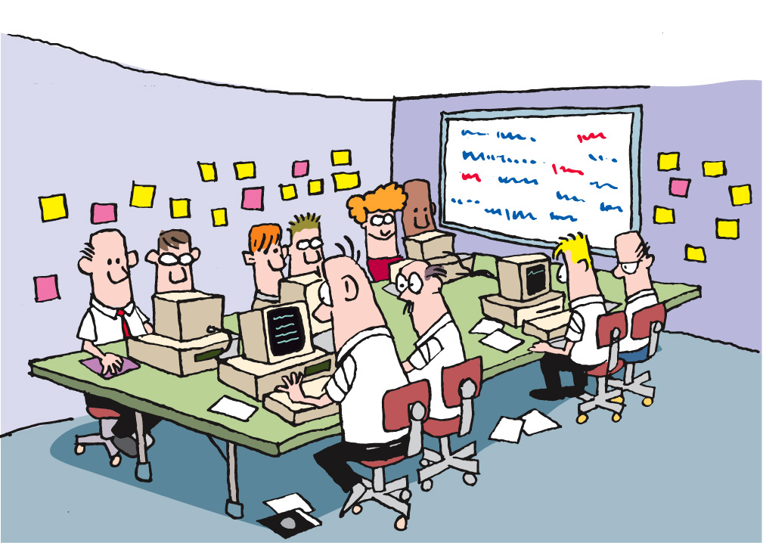
Team Room: Open Conversations
Notes:
Ideally everyone is collocated
PM/IM
DB
Business/Customer
Part time folks should have standard hours in the team room
--------------------------------------------------------------------------------------------------------------------
Part of the flow of your project is the flow of communication. Having a collocated team means that they are able to talk with each other easily. This eliminates the cost of tracking someone down when you need them, ensures that knowledge and experience gets freely shared among the members of the team, and increases the cohesion of the team.
Remember our discussion of context switching and lost time in the module The Agile Core? The collocated team addresses these and other issues by keeping everyone in close proximity. When you combine the time savings, the osmotic learning that takes place, and the ease of collaboration, we find that having a collocated team plays a significant role in contributing to the success of agile teams.

Slide 103
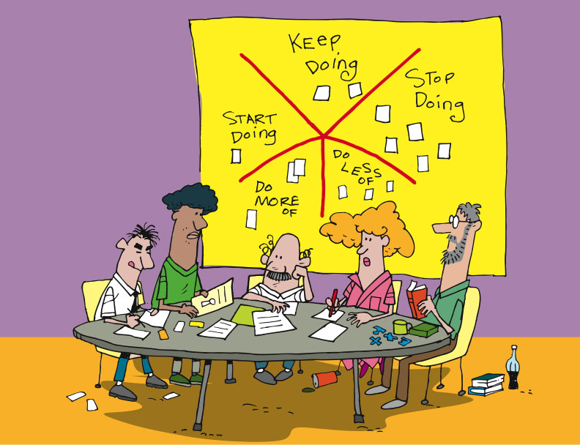
Retrospectives
“Whether you are using Agile methods or more traditional incremental or iterative development, your team has an opportunity to reflect at the end of every increment and identify changes and improvements that will increase the quality of the product and the work life of team members.”
Esther Derby and Diana Larsen
“…a well-run retrospective can help members of a community understand the need for improvement, and motivate them to change how they go about their work.”
Norm Kerth
http://www.thekua.com/rant/wp-content/uploads/2006/03/StarTechnique.gif
Notes:
Rodin, the artist, said
“Nothing is a waste of time if you use the experience wisely.”
Oscar Wilde said
“Experience is the name everyone gives to his mistakes.”
[CLICK]
Norm Kerth – 2000 – ‘Project Retrospective’ [CLICK]
Esther Derby and Diana Larsen – 2006 - wrote the book “Agile Retrospectives: Making Good Teams Great”.
[CLICK]
At the end of each Iteration, Release
Starfish model – Patrick Kua – TW
Review the model
Action items
Reduce waste, constant improvements
What’s the purpose of having a retrospective? It should be:
Informative – Communicate “the story” to all
Enlightening – Capture data, metrics or collective wisdom gained from the project
Progressive – Improve process/management/culture
Cathartic – Repair damage to the team or allow the team to enjoy what’s been accomplished
-----------------------------------------------------------------------------------------------------------
Rodin, the artist, said “Nothing is a waste of time if you use the experience wisely.”
Oscar Wilde said “Experience is the name everyone gives to his mistakes.”
And Kierkegaard said “Life can only be understood backward, but it must be lived forward.”
In 2001, Norm Kerth wrote the book “Project Retrospectives,” in which he said [CLICK] “a well-run retrospective can help members of a community understand the need for improvement, and motivate them to change how they go about their work.”
Following in Kerth’s footsteps, in 2006 Esther Derby and Diana Larsen wrote the book “Agile Retrospectives: Making Good Teams Great”. In their book, Esther and Diana said [CLICK] “Whether you are using Agile methods or more traditional incremental or iterative development, your team has an opportunity to reflect at the end of every increment and identify changes and improvements that will increase the quality of the product and the work life of team members.”
[CLICK] Agile teams generally include retrospectives as one of their practices. While different teams make different choices, it’s most common for teams to do retrospectives at each milestone – that is, at the end of each Iteration, Release, and at the end of the Project. We recommend Derby and Larsen’s book “Agile Retrospectives” as a key component of your team’s library. The activities and guidance in this book are priceless.
The goals of retrospectives, as stated by Kerth and Derby and Larsen, are to use the past – our experience – to improve our future. Whether it’s team functioning and communication – focused on the people – or technology, architecture, and technical practices, the goals are the same – learn and improve.

Slide 104
BA Huddle
Signoff
Escalation
Priorities
Narratives
Testing
Usability
Schedule
Regression
Risks
Staffing
Performance
SWAT
BA Lead
Timeline
Project
Sponsor
QA
Lead
Automation
Project Manager
Teams
Iteration
Managers
Product
Mgr
Scope
Progress
Priorities
Staffing
Risks
Architect
Tech Huddle
Vision
Features
Forecasts
Estimates
Technical
Debt
Risks
Test
Coverage

Slide 105
Cross Team Communication
Team 1 Iteration Manager | Team 2 Iteration Manager | Team 3 Iteration Manager | IM Huddle
Tech Lead | Tech lead | Tech Lead | Tech Huddle
Business Analyst | Business Analyst | Business Analyst | BA Huddle
Tester | Tester | Tester | QA Huddle
Developer | Developer | Developer | Learning Lunches and Patterns

Slide 106
Maintaining Visibility and Communications
Notes:
Accurate visibility into project progress has traditionally been a problem
Agile address this by making project status extremely visible to everyone
----------------------------------------------------------------------------------------------------------------
One of the exciting and powerful aspects of Agile is the free flow of information and communication. This is true both within an Agile team, and between the team and the rest of the organization. Agile teams talk about transparency, meaning that facts and information are freely available at all times, and that our successes and failures are equally visible.

Slide 107

Information Radiators
Notes:
Static sources of information available to anyone who chooses to view them.
No request needed
Always updated and ready to view [CLICK]
Standard ones [CLICK]
Custom ones
----------------------------------------------------------------------------------------------------
One of the tools for this communication and transparency is a category of things that we refer to as “information radiators”.
[CLICK]
Information radiators are static sources of information that are available to anyone who chooses to view them. By “static” we mean that there is no request needed and no specific interaction (although we’ll get back to this when we talk about Mingle). Rather, information radiators provide information simply by viewing them. Examples [CLICK] are the card wall and the burn-up chart which we touched on briefly a bit earlier in this module. The card wall is always there, and anyone can look at it and learn the state of the project, release, or iteration.

Slide 108

The Card Wall
Notes:
Card wall is in the team room
Easily accessible and visible
Mingle example [CLICK]
Not methodology dependent – scrum, lean, xp
Single iteration
Showing state of the card [CLICK] Ready for Analysis to Deployed
Some cards in next iteration – Analysts typically work iterations ahead of development
Clearly see the status of the iteration [CLICK] [CLICK]
--------------------------------------------------------------------------------------------------------
We’ve talked about the card wall throughout this course. Let’s look at it again, and an example of a card wall in Mingle.
[CLICK] It’s hard to overstate the value of the card wall. Regardless of the approach you follow – Scrum, XP, or Lean, for example – there is a card wall, and the value of it lies in its ability to communicate so clearly and completely, requiring little effort on the part of the reader.
Here’s an example of a representation of a card wall in Mingle. As you can see, this card wall is focused on a single Iteration, covering states [CLICK] from Ready for Analysis to Deployed. In many cases, the stories in the Ready for Analysis and In Analysis states are actually being prepared for the next Iteration. The work of Business Analysts is generally an Iteration ahead of the rest of the team, allowing them the time they need to figure out details and acceptance criteria so that the stories will be ready for the development team.
As you can see here, it’s easy to understand the state of the work being done in an Iteration on the card wall. For instance,[CLICK] we can see that there are a number of stories on which the work is complete that are waiting to be deployed. At the other end, [CLICK] there are a couple of stories that are ready for development, [CLICK] a few in development, and so on. Without even looking at the specific stories, [CLICK] we can learn a great deal about the project just by seeing the flow of work through viewing the card wall.

Slide 109

Daily Stand-Up
Notes:
Daily standup is important to visibility and communications
Communication flow is daily at a minimum
Minimal lags in work
Chickens can learn about day-to-day by attending
------------------------------------------------------------------------------------------------------------------
While we’ve talked about it before, it’s important to come back to Daily Stand-Ups again in the context of Visibility and Communications.
There are a number of goals accomplished by holding daily stand-ups.
Doing them daily means that the communication flow is consistent. It also means that there are minimal lags – we all know what we’re all doing very immediately, without having to wait for status reports. It also means that others – managers, stakeholders – can learn about what’s going on day-by-day by attending a daily standup. That assumes that the team gives permission for others to attend, of course.

Slide 110

Reporting Progress – Burn Down
Notes:
2 primary radiators – Burn up and burn down
Comes directly from SCRUM
Same info in slightly different format
What we have to do [CLICK]
And when we are done [CLICK]
Release and/or iteration level charts
---------------------------------------------------------------------------------------------------
There are two primary reports that are used by Agile teams: the Burn Down chart, and the Burn Up Chart. The Burn Down chart comes directly from Scrum. Both charts represent the same information, fundamentally, but in a slightly different presentation.
The Burn Down chart approach is to start with the assumption that we know how much work we have to do [CLICK], and that we know we’re done when there’s nothing left to do [CLICK]. This is used for release level reporting, and is based on the practice of identifying all stories to be done during this release, and assuming that there will be no changes. While it is adaptable, and can accommodate changes in scope, it is not as clear, in our estimation, as…

Slide 111

Project Burn-Up
Scope
Velocity
Notes:
Burn-Up Chart
Primarily discussion, with an example of a burn-up chart

Slide 112

Showcases
Notes:
Goal - Working software at the end of each iteration
Showcase at the end of each iteration
Not design session or brainstorming
We do get feedback
Feedback may turn into new stories
For the chickens
-------------------------------------------------------------------------------------------------
With the goal of ensuring that information and knowledge are spread throughout team and stakeholders, and that the team gets valuable feedback as early as possible, we follow each Iteration with a showcase.
During the showcase, we show what has been done during the Iteration just completed. This is not a design session, nor a brainstorming session. The purpose of the showcase is to say “here’s what we’ve gotten done” and to solicit input from the participants. It is not unusual for additional stories to be generated as a result of the showcase, as stakeholders gain a greater understanding of what is actually being delivered and the value that goes with that.
This is not to say that we don’t share what we’re doing prior to the showcase. It’s that the showcase is the time when we say “this is what we’ve gotten done” and actively seek feedback from stakeholders who are not normally involved on a daily basis – the Chickens.

Slide 113

Managing Risks and Issues
Notes:
Not unique to Agile – Risk and issue tracking
The many additional ways to identify risk
Showcases
Customer collaboration
Daily standups
Planning meetings
Mingle risk tracking example
---------------------------------------------------------------------------------------------------------------
We’re almost there!
Every undertaking has risks and issues. Risks are forward looking – things that might happen. Issues are backward-looking – things that have happened.
Agile teams make every effort to identify risks – things that could get in the way of successfully completing the project. When possible, mitigation strategies will be identified and put in place. This means that we might be able to avoid the risk if we take the right steps. On the other hand, some risks cannot be avoided – they will become issues, it’s just a matter of when. However, by thinking them through and identifying them in advance, we can be far more prepared.
We record risks and issues so that we can be sure not to lose the benefit of the thinking that went into the process. On this slide, you see a risk log being maintained in Mingle.
Whether you use Mingle, Excel, or a card wall to record and track your risks and issues, record and track them you must.

Slide 114
Review
Purpose and attributes of stories
Relationship of stories, acceptance criteria and testing
Roles and personas and scenarios
Estimate agile stories
Plan using estimates, spikes and velocity
Agile lifecycle and planning cadence
Agile metrics and communication

Slide 115
Questions?

